Slide 1


Instructor Resources
Appendix 2 Figures
Cover photo: BeautyStock – stock.adobe.com.

Slide 2
Appendix 2
Airline, Regional, and Business Aircraft Spotter’s Guide

Slide 3
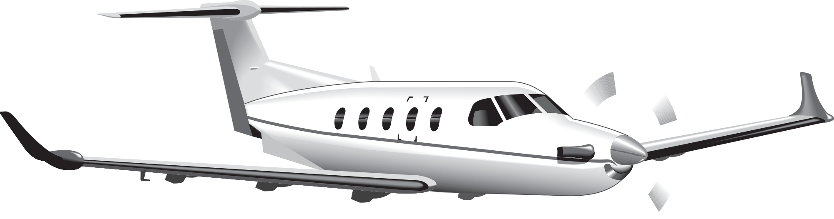
1.
Pilatus Aircraft LTD. PC-12
Powerplant: one Pratt & Whitney PT-6 turboprop.
Seats: 6–9.
Cruise speed: 270 knots.
Distinctive features: large cabin for a single-engine plane; extended nose cowling; large dual exhaust pipes, one on either side of nose cowling; T-tail.

Slide 4
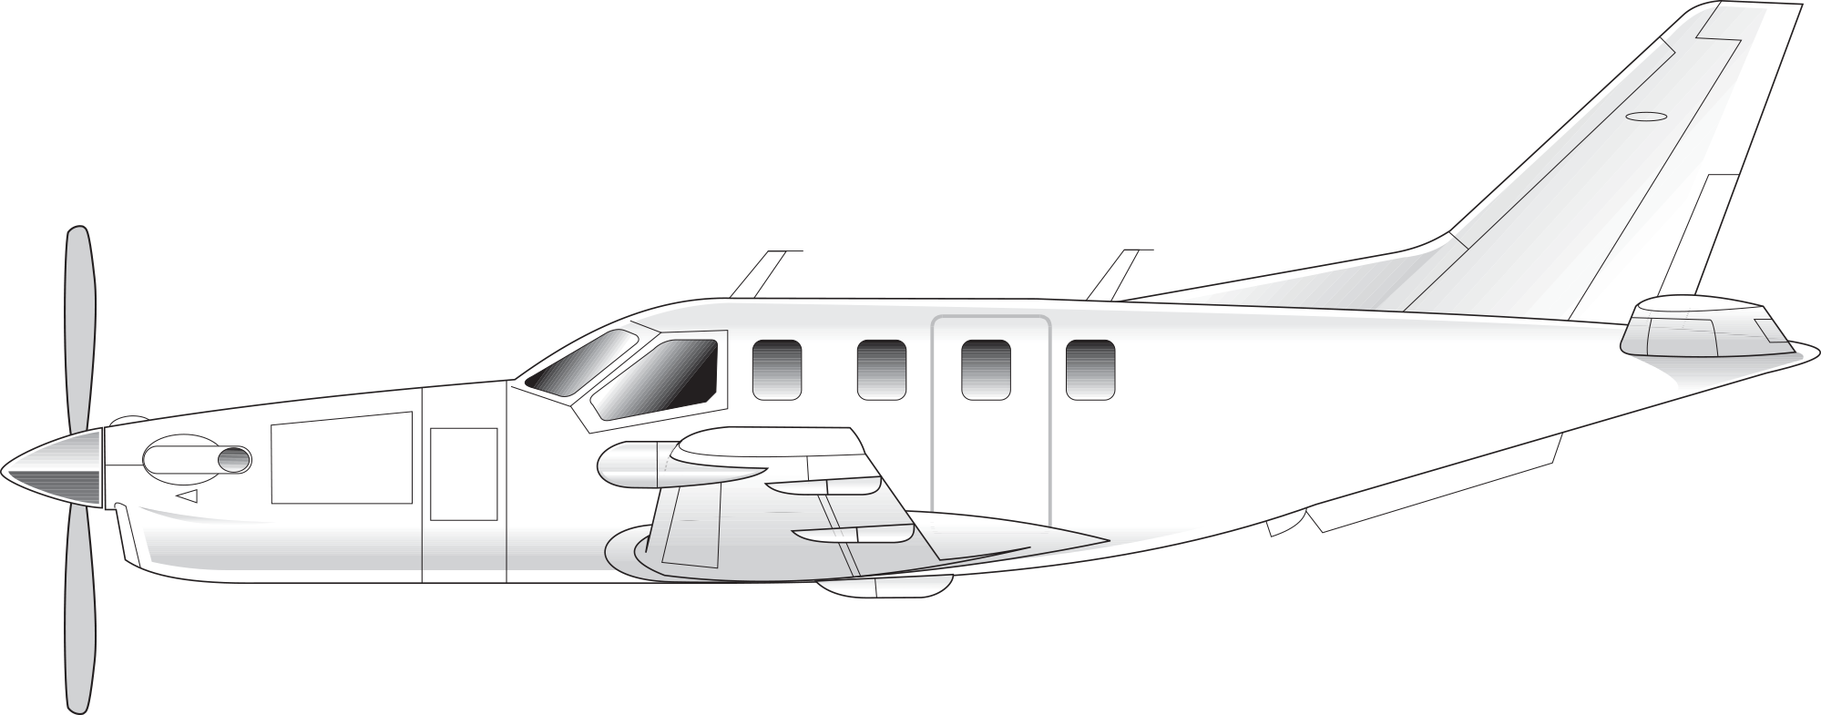
2.
Socata TBM700/TBM850/TBM900 Series
Powerplant: one Pratt & Whitney PT-6 turboprop.
Seats: 4–6 passengers.
Cruise speed: 300 knots.
Distinctive features: large, triangular, flight deck side windows; extended nose cowling.

Slide 5
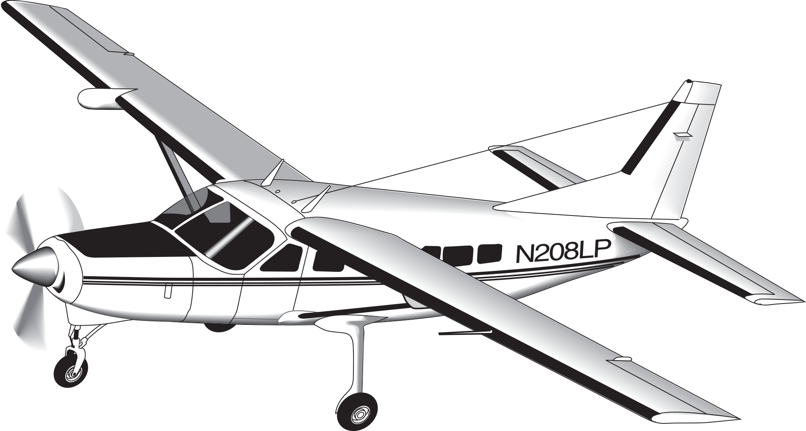
3.
Cessna 208 Caravan
Powerplant: one Pratt & Whitney PT6 turboprop.
Seats: up to 13.
Cruise speed: 170 knots.
Distinctive features: high-wing; long sloping windscreen; large fixed landing gear; usually has an externally mounted baggage compartment on aircraft belly.

Slide 6
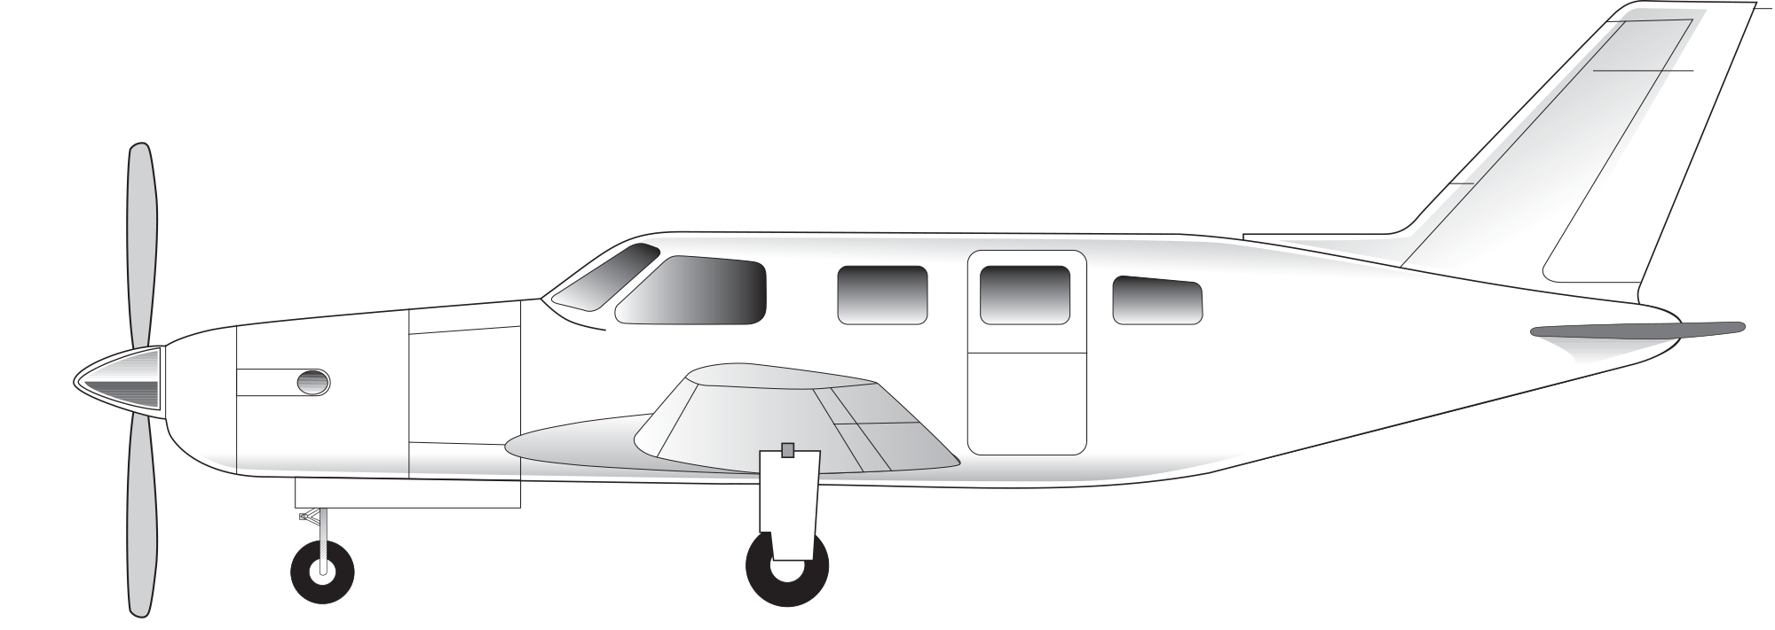
4.
Piper M500 and M600 Turboprop
Powerplant: one Pratt & Whitney Canada PT6A-42A.
Seats: up to six passengers.
Cruise speed: 275 knots.
Distinctive features: large dual exhaust pipes, one on either side of nose.

Slide 7
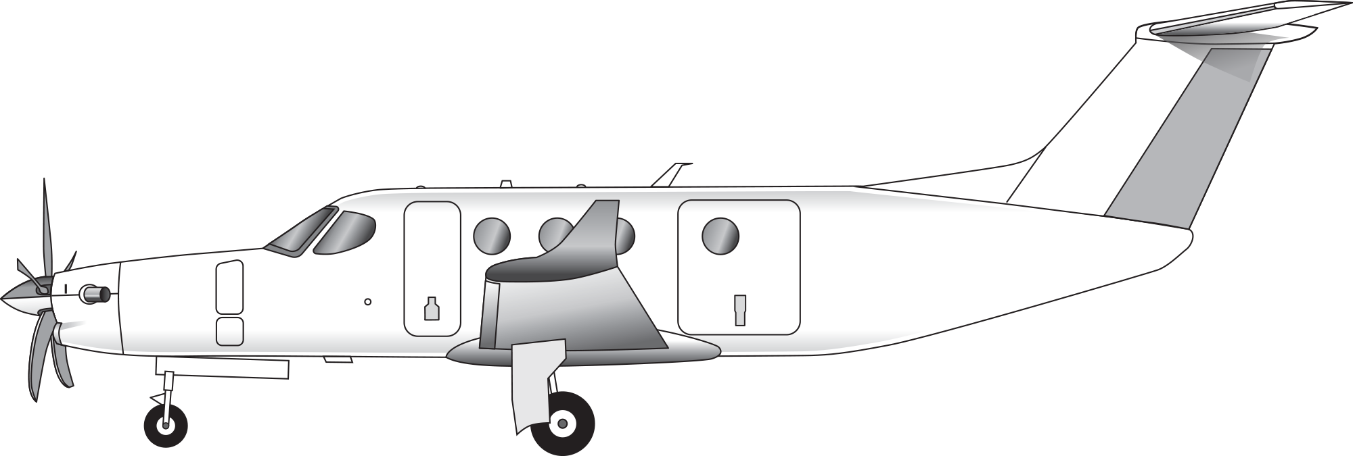
5.
Cessna Denali
Powerplant: one General Electric GE93.
Seats: 8–11 passengers.
Cruise speed: 285 knots.
Distinctive features: tall T-tail; advanced five-bladed propeller.

Slide 8
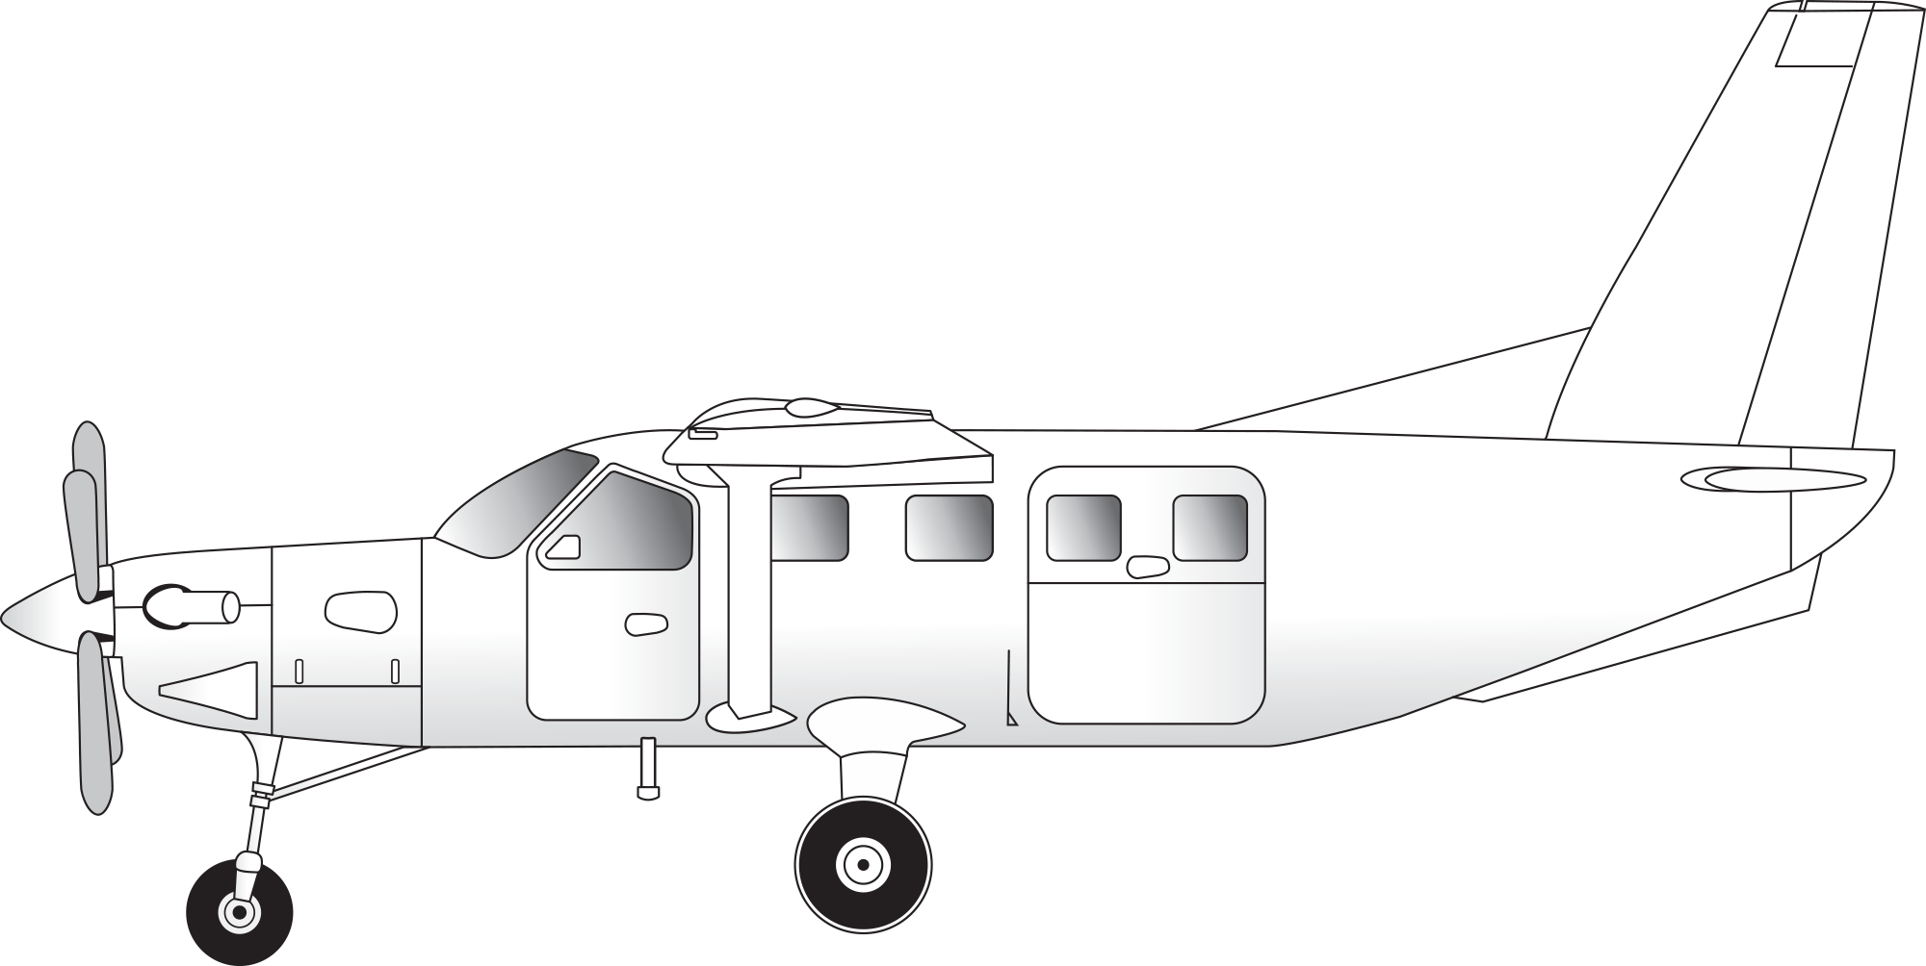
6.
Daher Kodiak 100 and 900
Powerplant: one Pratt & Whitney PT6 turboprop.
Seats: up to 9 passengers.
Cruise speed: 210 knots.
Distinctive features: Single-engine, high wing design similar to Cessna 208 but with a narrower nose; many have two ventral fins under the tail.

Slide 9
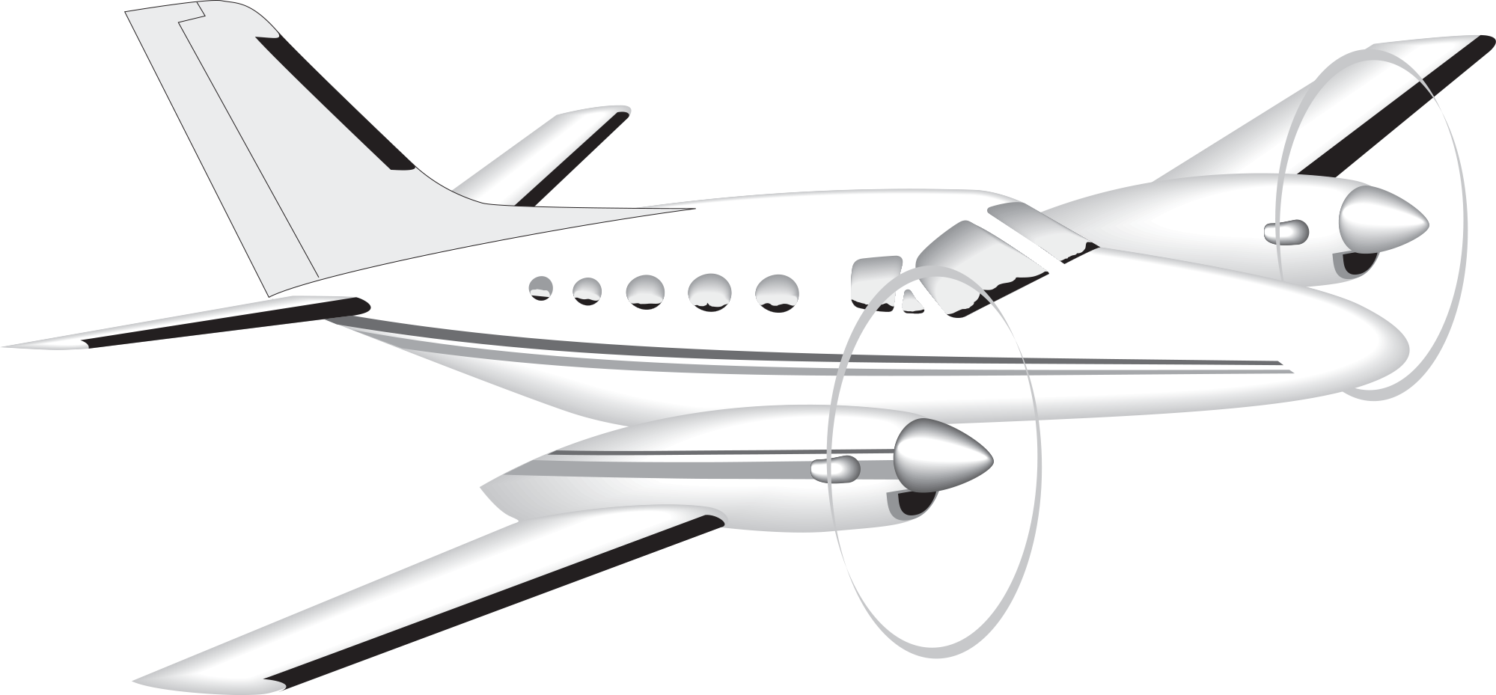
7.
Cessna Conquest I/II
Powerplants: two Garrett TPE 331 or Pratt & Whitney PT6 turboprops.
Seats: up to 10 passengers.
Cruise speed: 250 knots.
Distinctive features: long rounded nose, flattened on top.

Slide 10
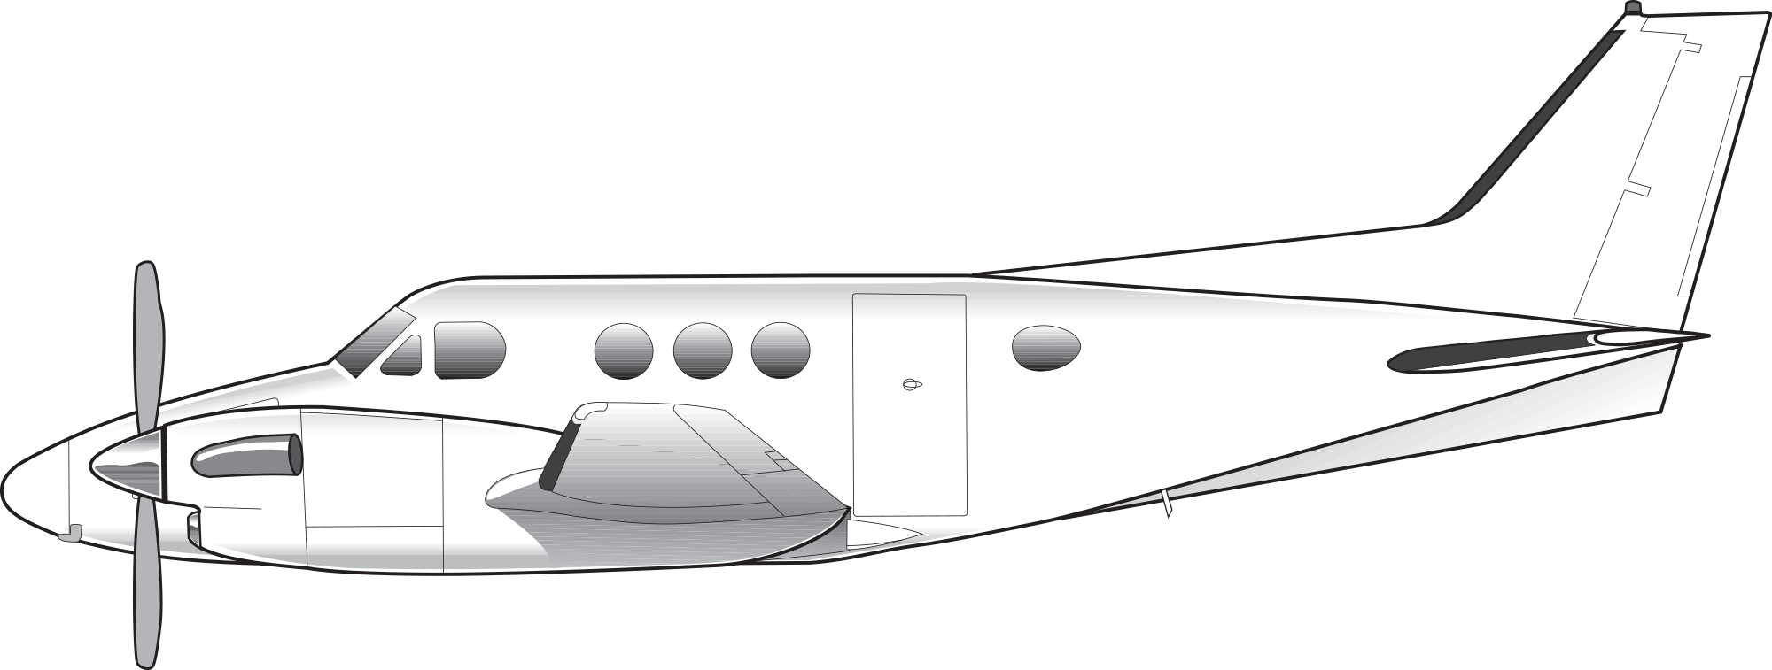
8.
Beechcraft King Air Series 90
Powerplants: two Pratt & Whitney PT6 turboprops.
Seats: up to 7 passengers.
Cruise speed: 245 knots.
Distinctive features: short, stubby nose; fairly large fuselage for its length.

Slide 11
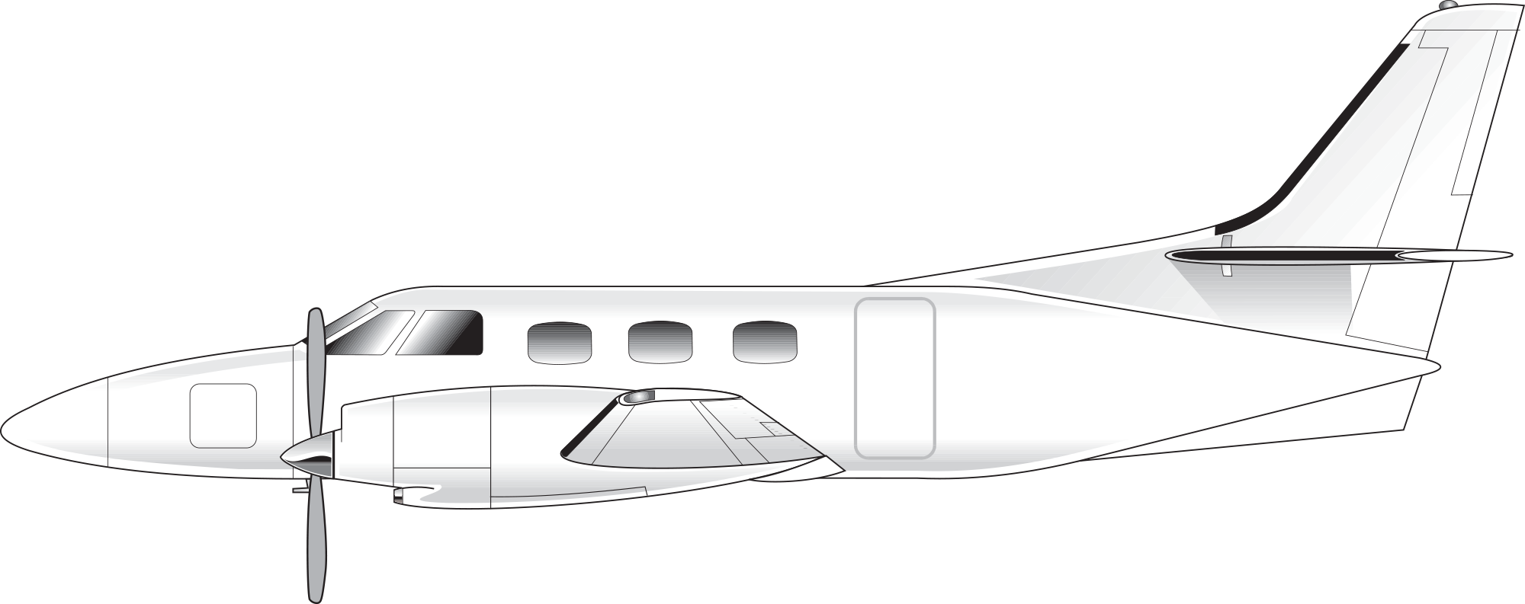
9.
Fairchild Merlin
Powerplants: two Garrett TPE 331 turboprops.
Seats: up to 12 passengers.
Cruise speed: 280 knots.
Distinctive features: narrow tubular fuselage; long, narrow nose.

Slide 12
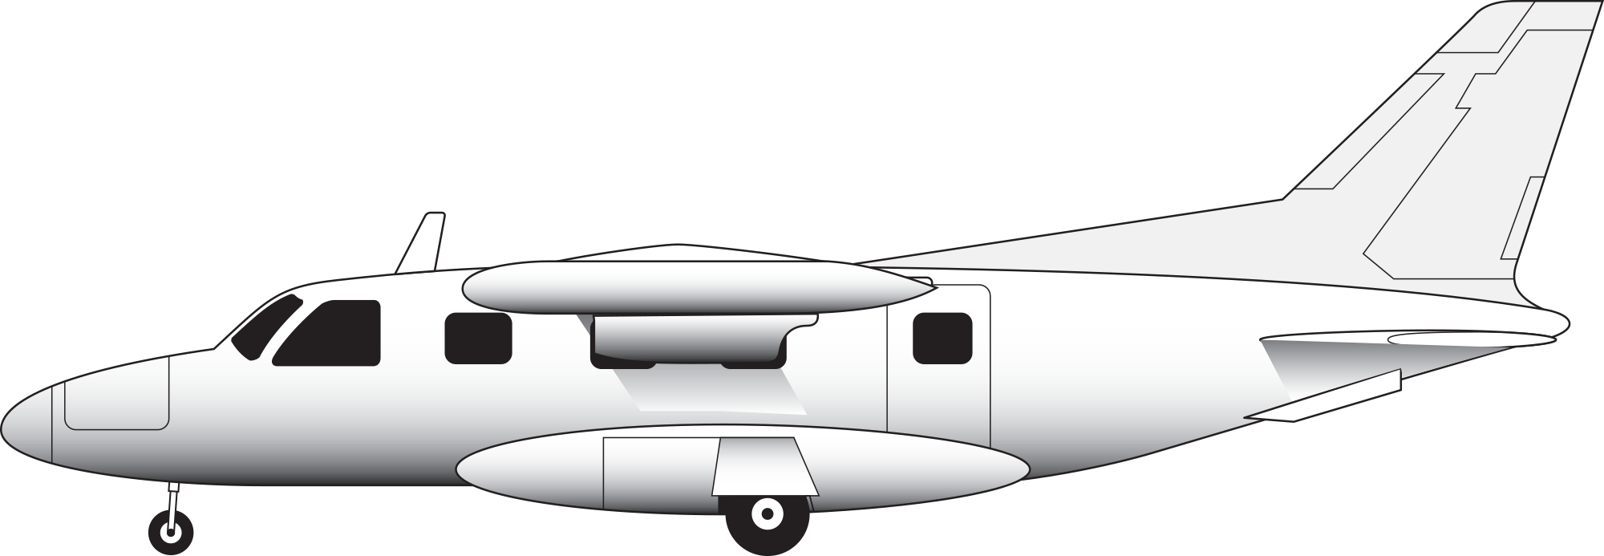
10.
Mitsubishi MU-2
Powerplants: two Garrett TPE 331 turboprops.
Seats: up to 12 passengers.
Cruise speed: 290 knots.
Distinctive features: small, high wings; tip tanks.

Slide 13
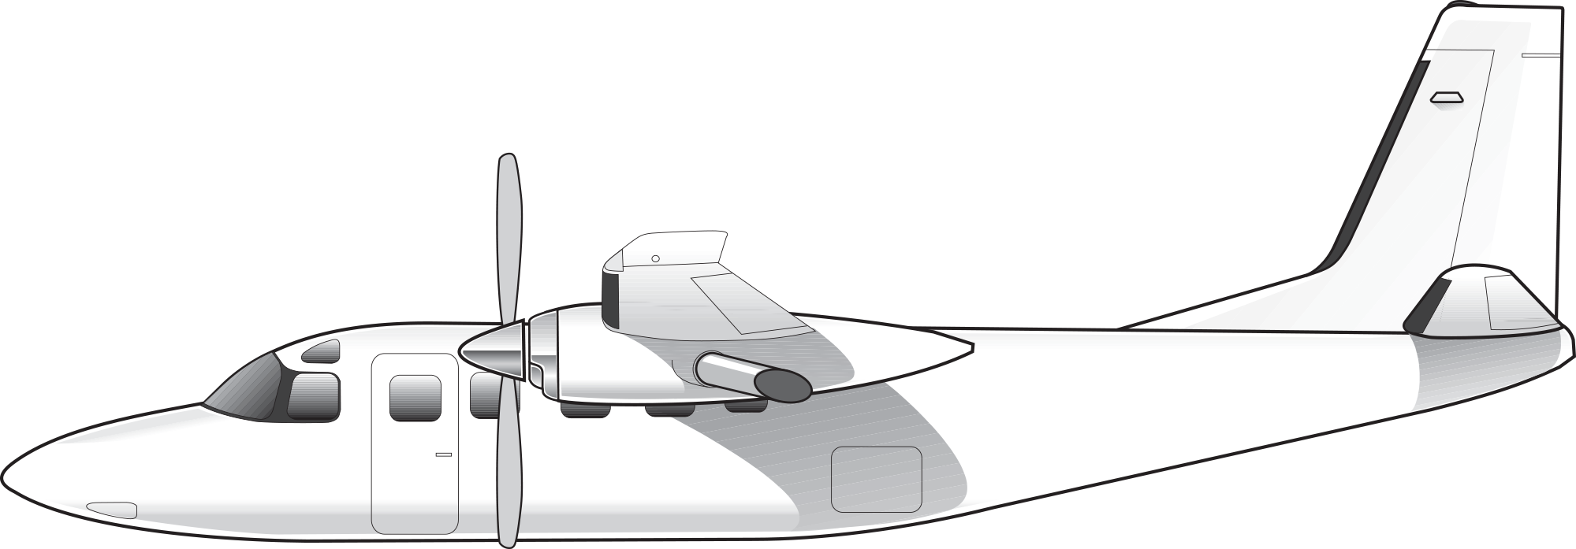
11.
Turbo Commander Series
Powerplants: two Garrett TPE 331 turboprops.
Seats: up to 10 passengers.
Cruise speed: 275 knots.
Distinctive features: high wings; pointed nose; fuselage sits very low on the ramp.

Slide 14
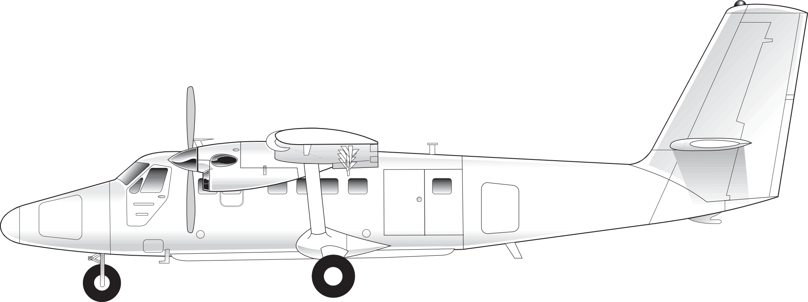
12.
DHC-6/Viking Air Twin Otter
Powerplants: two Pratt and Whitney PT-6A turboprops.
Seats: up to 19 passengers.
Cruise speed: 150 knots.
Distinctive features: rugged-looking aircraft; large straight wings; tall, fairly straight tail; and non-retractable landing gear.

Slide 15
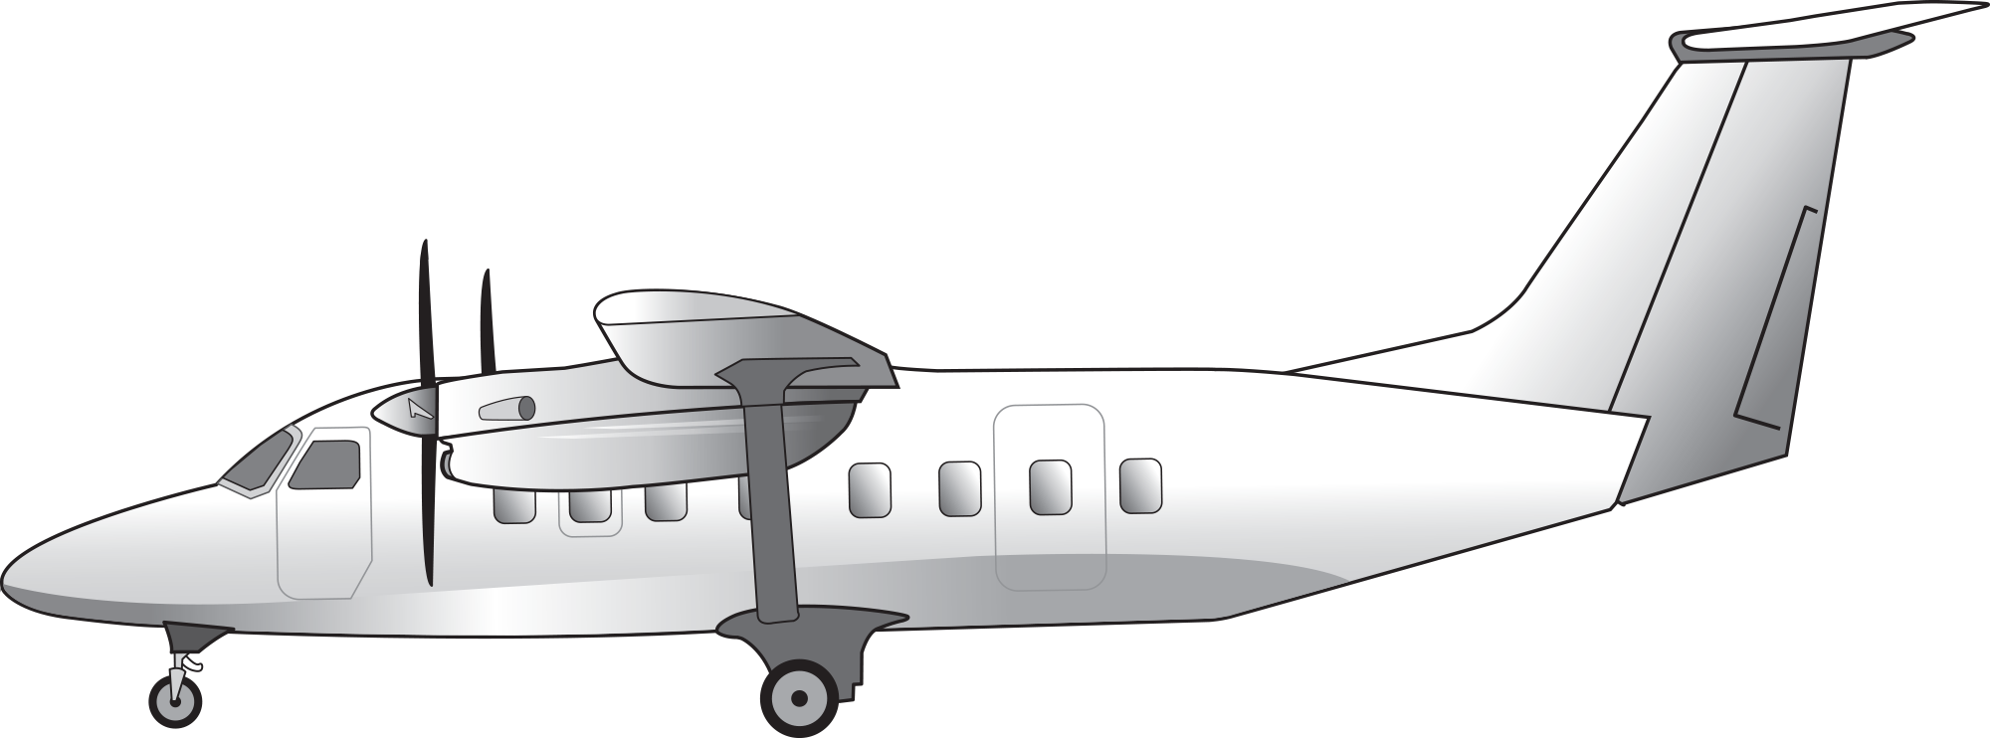
13.
Cessna SkyCourier
Powerplants: two Pratt & Whitney PT6 turboprops.
Seats: up to 19 passengers.
Cruise speed: 210 knots.
Distinctive features: Flight deck side doors (each pilot has a flight deck door); high wing with large wing struts; tall T-tail; fixed gear.

Slide 16
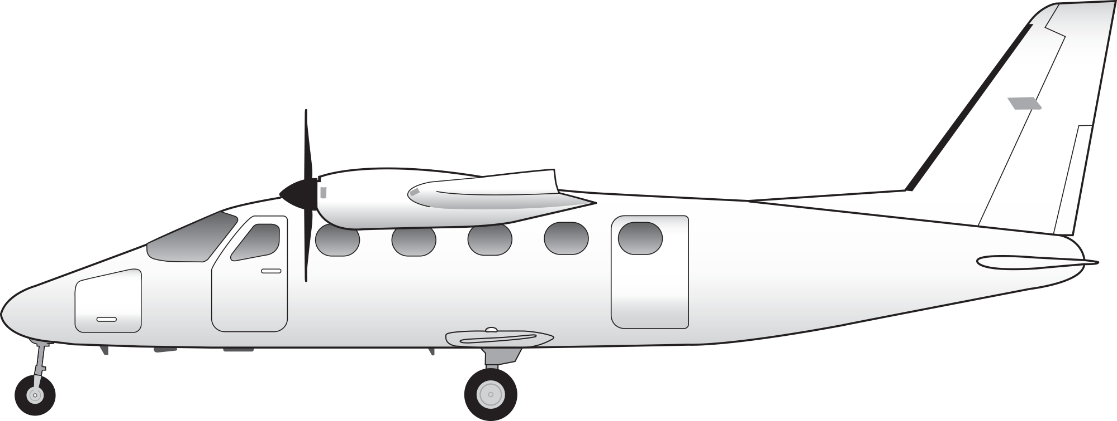
14.
Tecnam P2012 Traveller (piston-powered)
Powerplant: Lycoming TEO540 or Continental GTSIO-520 piston engines.
Seats: up to 11 seats.
Cruise speed: 170 knots.
Distinctive features: high wing without wing struts; piston engines; fixed gear; long nose; low tailplane.

Slide 17
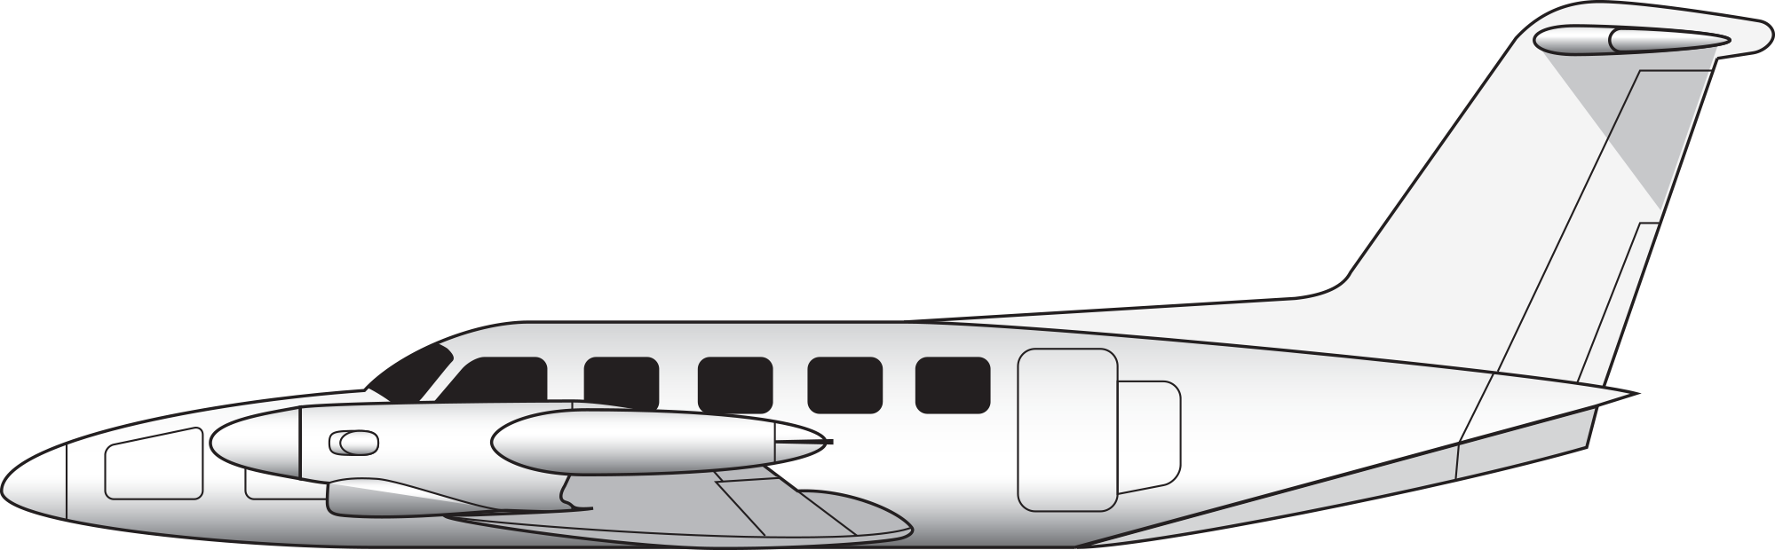
15.
Piper Cheyenne
Powerplants: two Garrett TPE 331 or Pratt & Whitney PT6 turboprops.
Seats: up to 10 passengers.
Cruise speed: 260–330 knots, depending on model.
Distinctive features: relatively large T-tail; small wing tip tanks (early models have conventional tails).

Slide 18
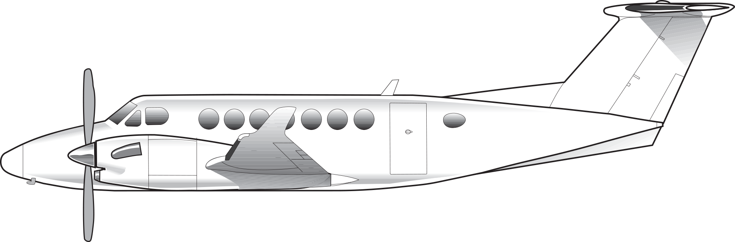
16.
Beechcraft Super King Air 200 and 300 Series
Powerplants: two Pratt & Whitney PT6 turboprops.
Seats: up to 15 passengers.
Cruise speed: 290 knots.
Distinctive features: T-tail; some models have winglets.

Slide 19
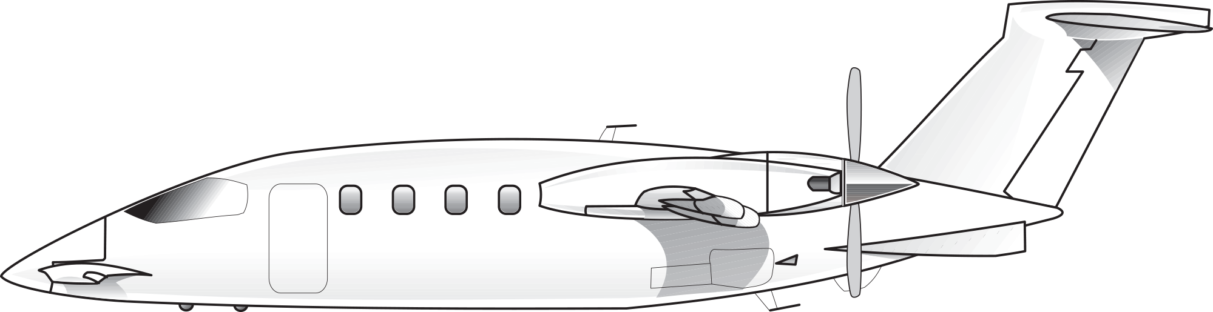
17.
Piaggio Avanti
Powerplants: two Pratt & Whitney PT6 turboprops.
Seats: up to 9 passengers.
Cruise speed: 320 knots.
Distinctive features: three-surface design includes main and forward wings and T-tail; large wraparound flight deck windows.

Slide 20
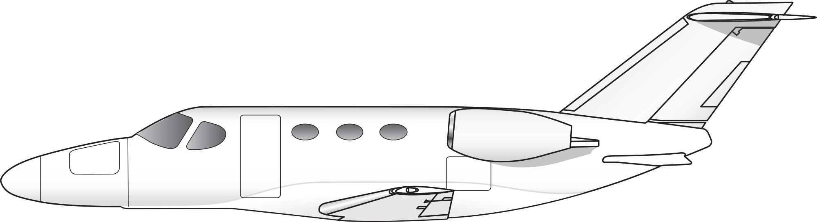
18.
Cessna Citation Mustang
Powerplants: two Pratt & Whitney PW615 turbofan engines.
Seats: up to 5 passengers.
Cruise speed: 340 knots.
Distinctive features: small overall size; long nose; small aerodynamic strakes on bottom of tail.

Slide 21
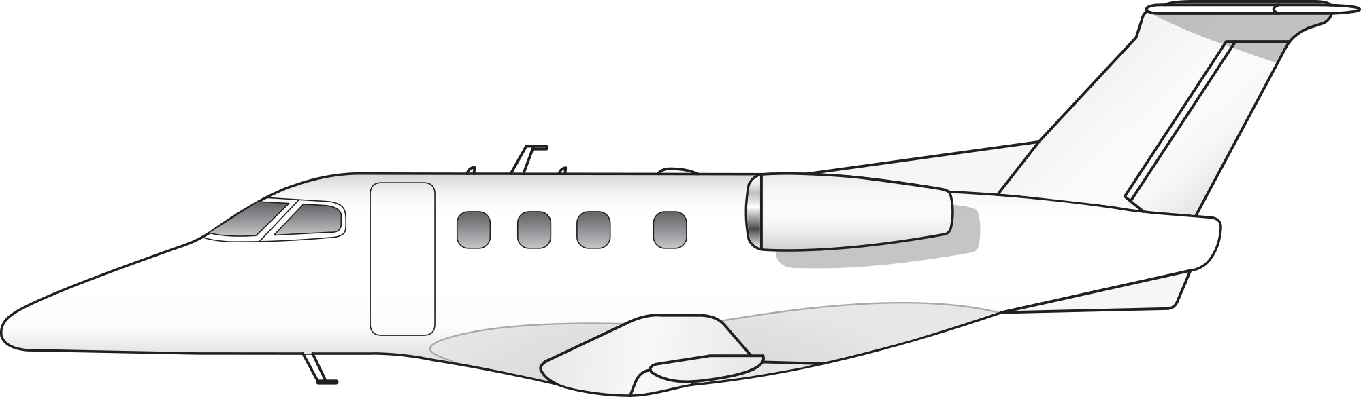
19.
Embraer Phenom 100
Powerplants: two Pratt & Whitney PW617 turbofan engines.
Seats: up to 6 passengers.
Cruise speed: 350 knots.
Distinctive features: small overall size; distinctive Embraer long-sloped nose.

Slide 22
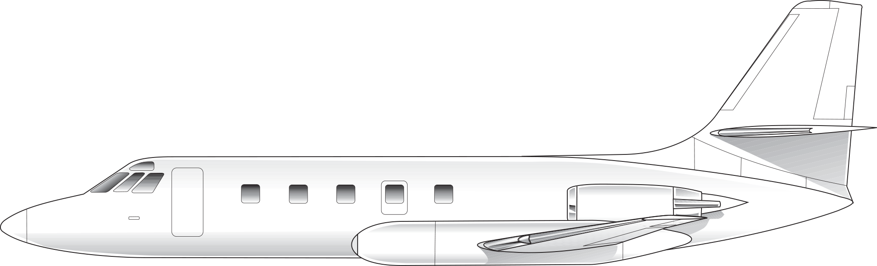
20.
Lockheed JetStar
Powerplants: four Garrett TFE 731 turbofan engines.
Seats: up to 10 passengers.
Cruise speed: 440 knots.
Distinctive features: four tail-mounted engines; large external under-wing fuel tanks.

Slide 23
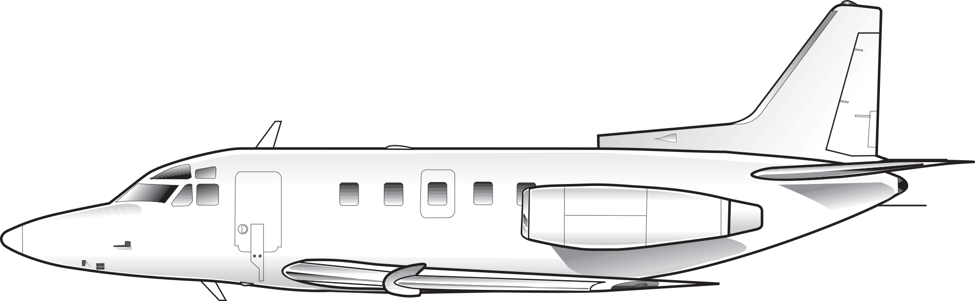
21.
Rockwell Sabreliner
Powerplants: two Pratt & Whitney JT12 turbojets, Garrett TFE 731, or General Electric CF700 turbofan engines.
Seats: up to 7 passengers.
Cruise speed: 430 knots.
Distinctive features: flight deck “eyebrow windows;” older models have triangular passenger windows.

Slide 24
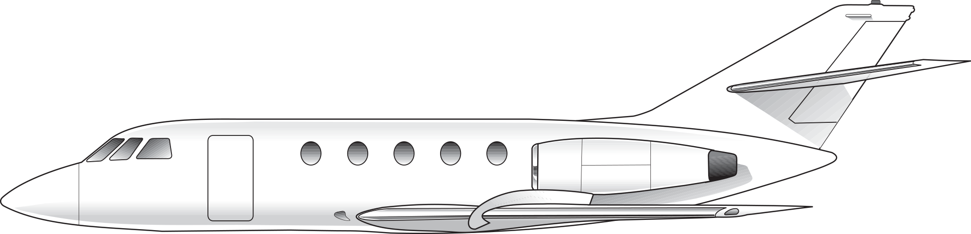
22.
Dassault Falcon 20
Powerplants: two General Electric CF700 or Garrett TFE 731 turbofan engines.
Seats: up to 10 passengers.
Cruise speed: 410 knots.
Distinctive features: large flight deck windows typical of most Falcon models.

Slide 25
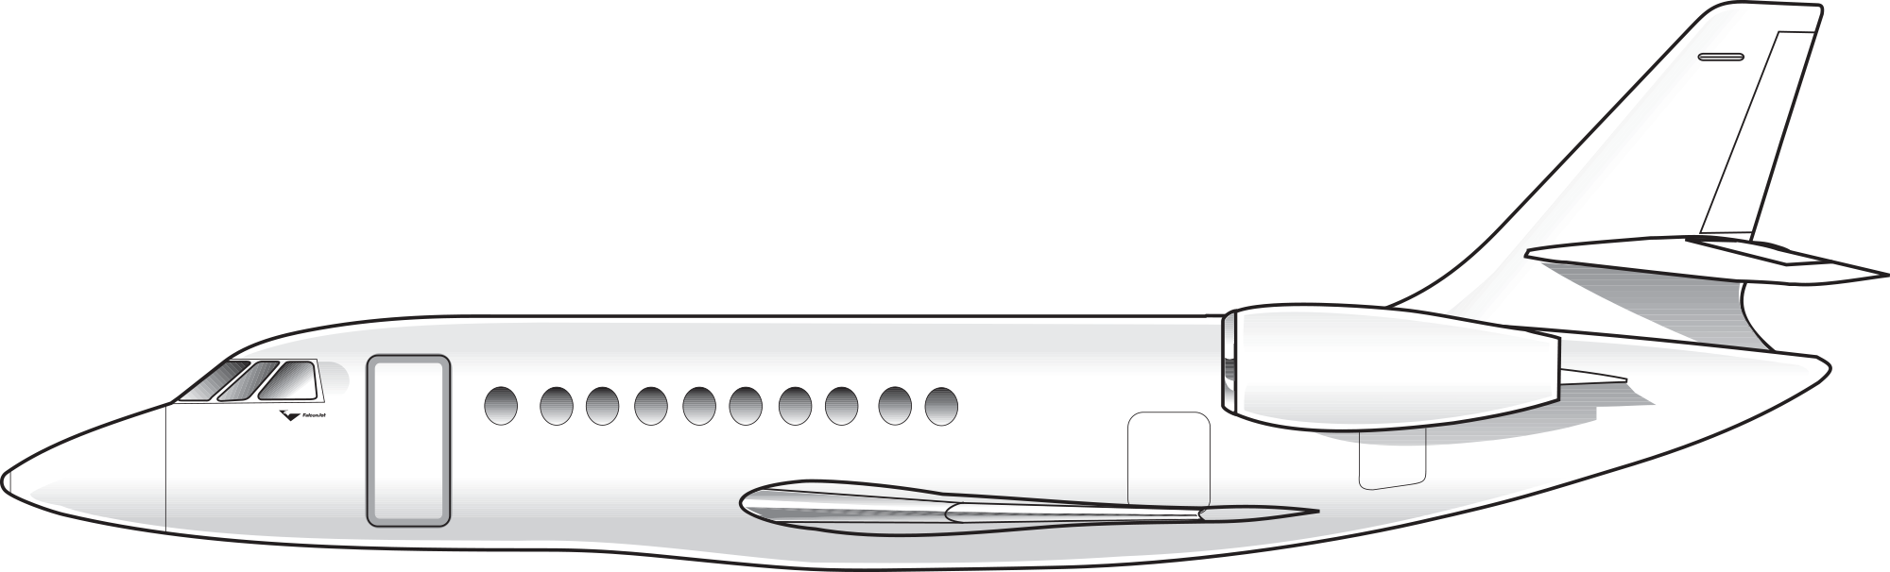
23.
Dassault Falcon 2000/5X
Powerplant: two General Electric/Allied Signal CFE738, or Pratt & Whitney PW308, or Safran Snecma (Falcon 5X) turbofan engines.
Seats: up to 10 passengers (Falcon 2000); up to 16 passengers (Falcon 5X).
Distinctive features: relatively large engines for a corporate jet; horizontal tail has noticeable anhedral.

Slide 26
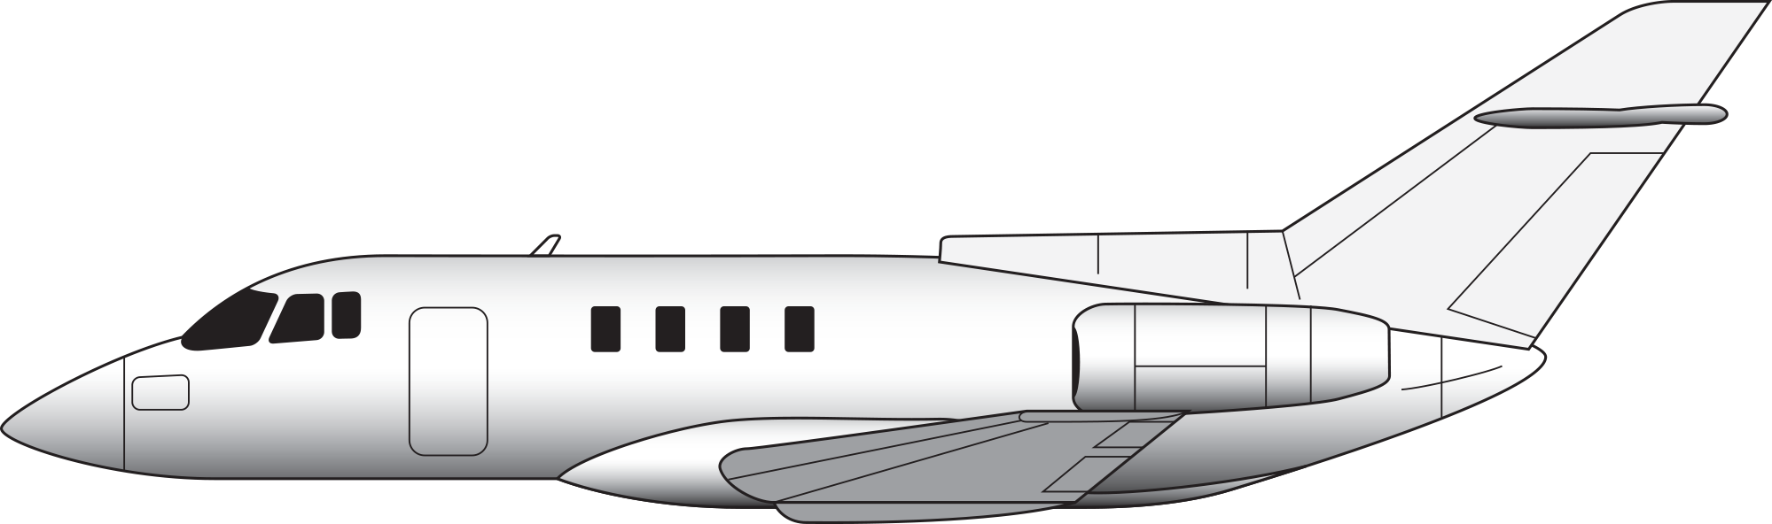
24.
British Aerospace 125 (BAe 125; formerly HS 125)
Powerplants: two Garrett TFE 731 turbofan engines.
Seats: up to 14 passengers.
Cruise speed: 410 knots.
Distinctive features: pointed nose; small accessory intake at base of vertical stabilizer; four passenger windows.

Slide 27
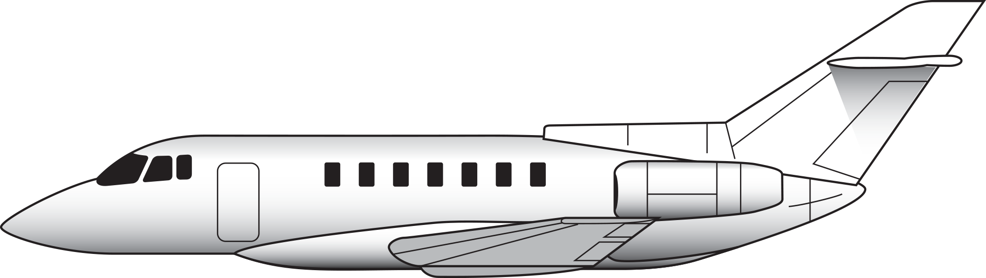
25.
Hawker 800/1000
Powerplants: two Garrett TFE 731 or Pratt & Whitney PW305 turbofan engines.
Seats: up to 9 passengers.
Cruise speed: 405 knots.
Distinctive features: pointed nose; wraparound flight deck windows; accessory intake at base of vertical stabilizer; six passenger windows (800), or seven passenger windows (1000).

Slide 28
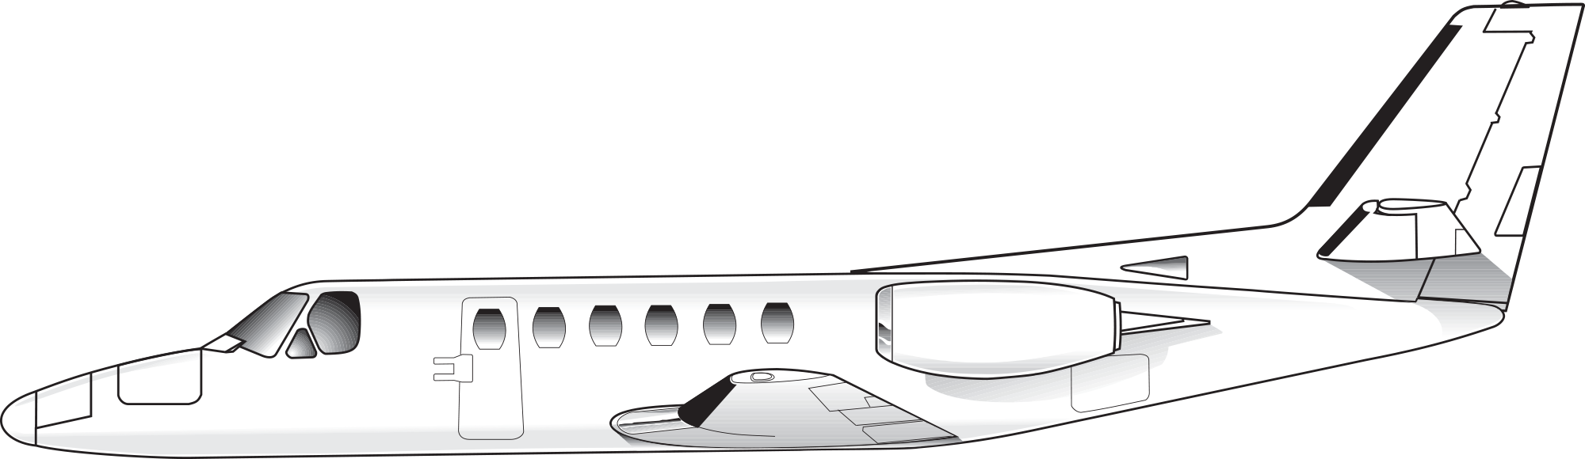
26.
Cessna Citation Series I/II/III/V/Bravo/Encore/Excel/ Sovereign
Powerplants: two Pratt & Whitney PW JT15D, PW535 or PW545 turbofan engines.
Seats: up to 12 passengers.
Cruise speed: 340–420 knots.
Distinctive features: large flight deck windows; straight wings (Excel and Sovereign have multi-pane windshields and utilize a shortened Citation X fuselage).

Slide 29
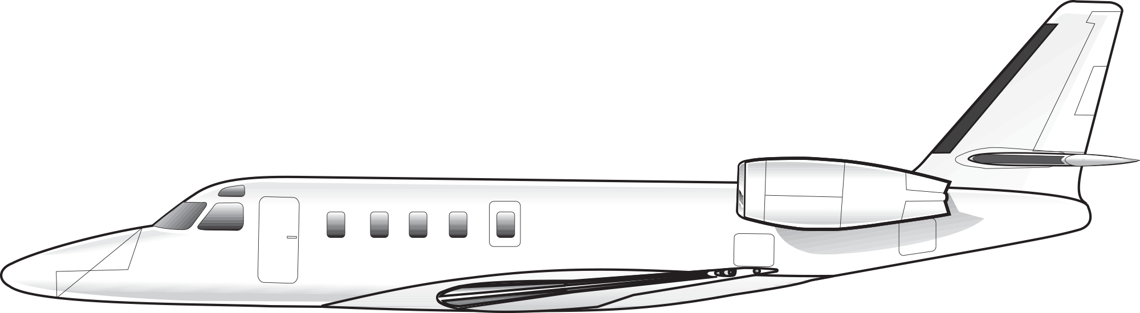
27.
IAI Astra/Gulfstream G100
Powerplants: two Garrett TFE 731 turbofan engines.
Seats: up to 9 passengers.
Cruise speed: 450 knots.
Distinctive features: swept wing; small flight deck eyebrow windows above pilots’ heads.

Slide 30
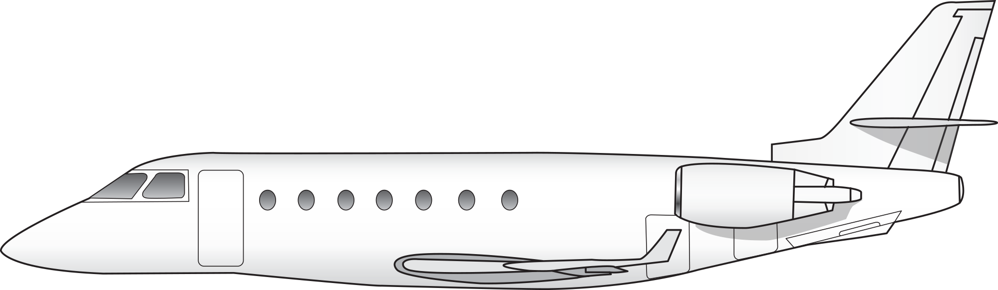
28.
IAI Galaxy/Gulfstream G200 Series
Powerplants: two Pratt & Whitney PW306 turbofan engines.
Seats: up to 8 passengers.
Cruise speed: 450 knots.
Distinctive features: low wing attached to bulge below fuselage; classic Gulfstream wing.

Slide 31
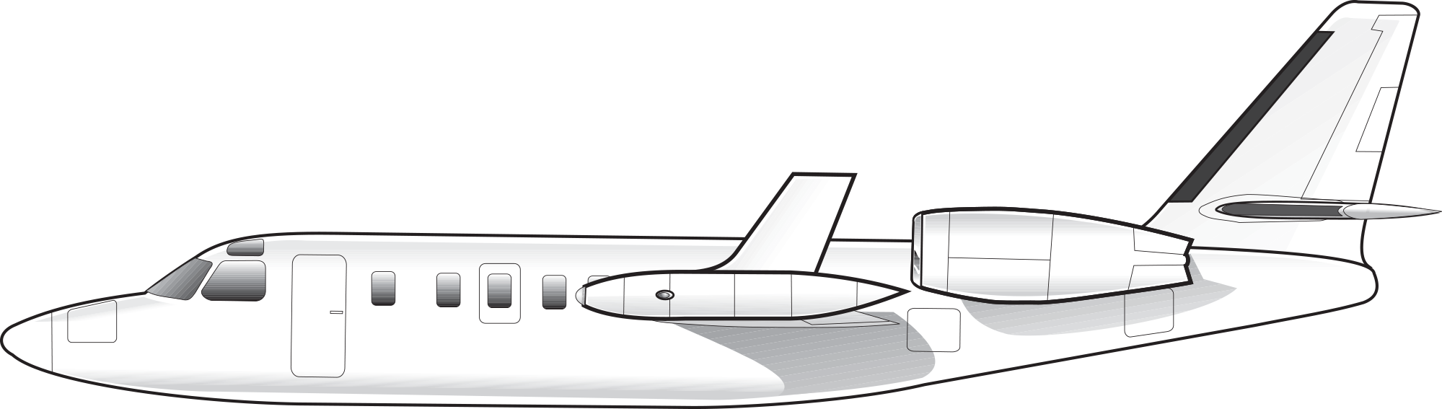
29.
Israel Aircraft Industries Westwind 1124
Powerplants: two Garrett TFE 731 turbofan engines.
Seats: up to 10 passengers.
Cruise speed: 400 knots.
Distinctive features: straight wings; unusual wing tip tanks, with winglets on later models.

Slide 32
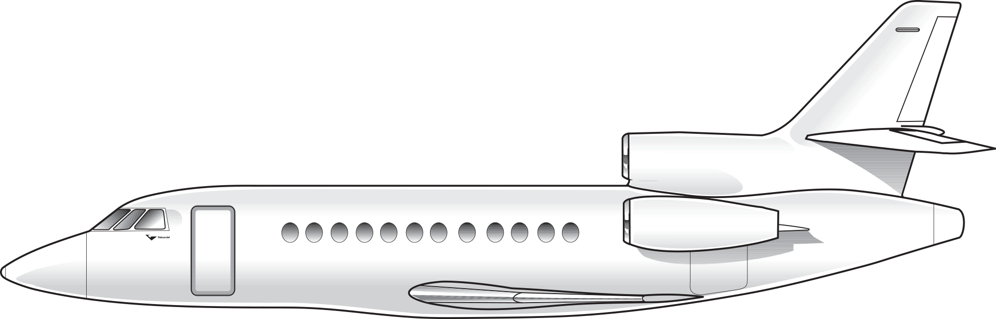
30.
Dassault Falcon 50/900/7X/8X/9X
Powerplants: three Garrett TFE 731 or PW307 turbofan engines.
Seats: up to 9 (Falcon 50), up to 19 (Falcon 900), up to 14 (Falcon 7X).
Cruise speed: 470–485 knots.
Distinctive features: typical Falcon flight deck windshield; three engines; horizontal stabilizer has a slight anhedral.

Slide 33
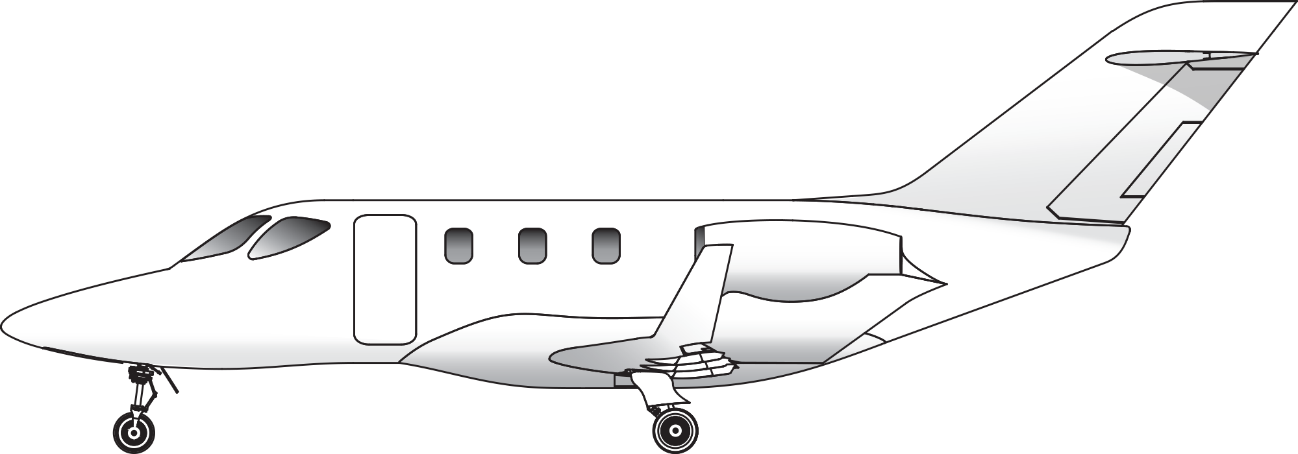
31.
Hondajet HA420
Powerplants: two GE/Honda HF120 turbofan engines.
Seats: up to 6 passengers.
Cruise speed: 400 knots.
Distinctive features: unique over-the-wing engine pylon mount; triangular flight deck side window.

Slide 34
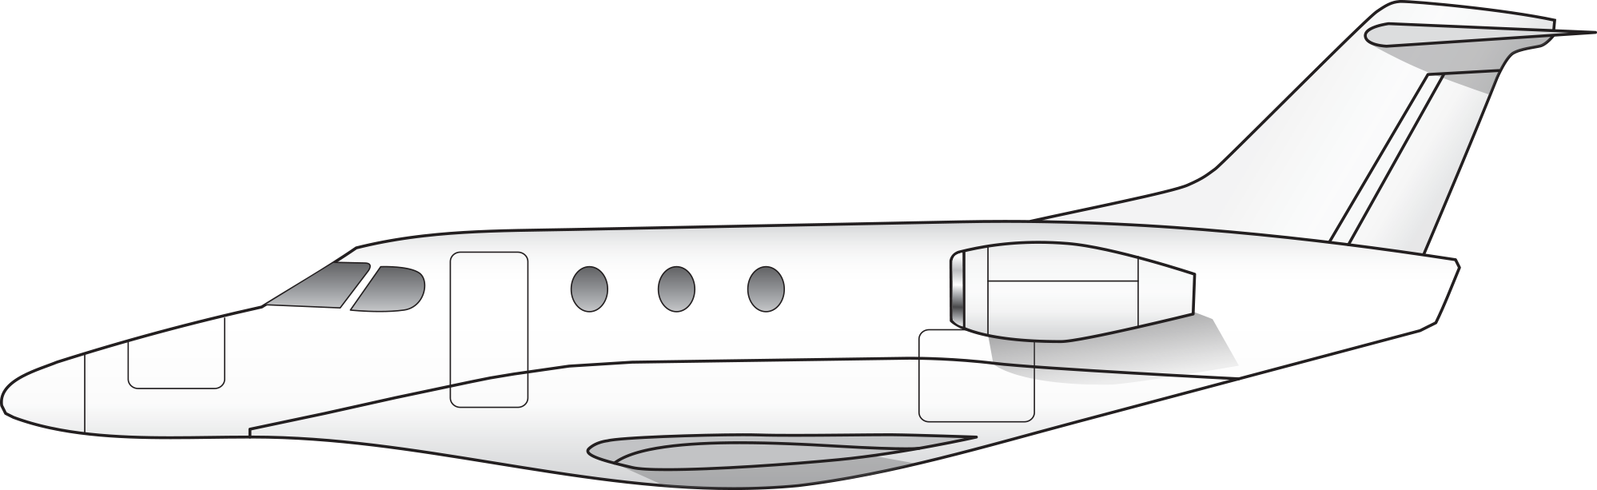
32.
Beechcraft Premier
Powerplants: two Williams FJ44 turbofan engines.
Seats: up to 6 passengers.
Cruise speed: 460 knots.
Distinctive features: long sloping nose; low wing mounted on extended fuselage belly, small-diameter engine intakes.

Slide 35
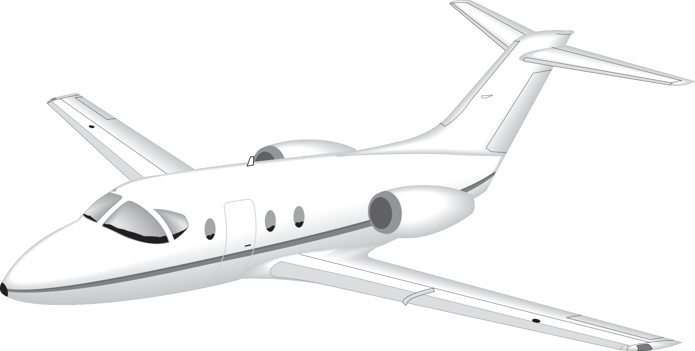
33.
Beechjet 400
Powerplants: two Pratt & Whitney JT15D turbofan engines.
Seats: up to 9 passengers.
Cruise speed: 450 knots.
Distinctive features: unique flight deck window arrangement with side window frame angled diagonally forward.

Slide 36
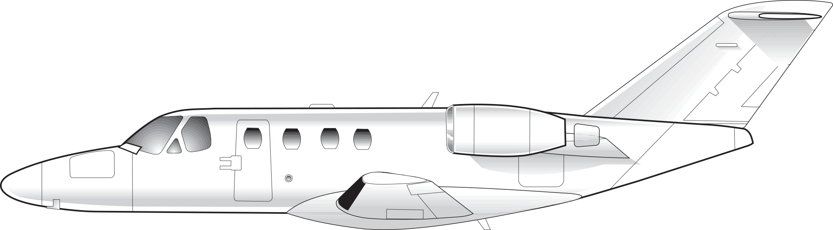
34.
Cessna Citation CJ Series
Powerplants: two Williams-Rolls FJ44 turbofan engines.
Seats: 5–7 passengers.
Cruise speed: 370–400 knots.
Distinctive features: smallest Citation; straight wings; small engine nacelles.

Slide 37
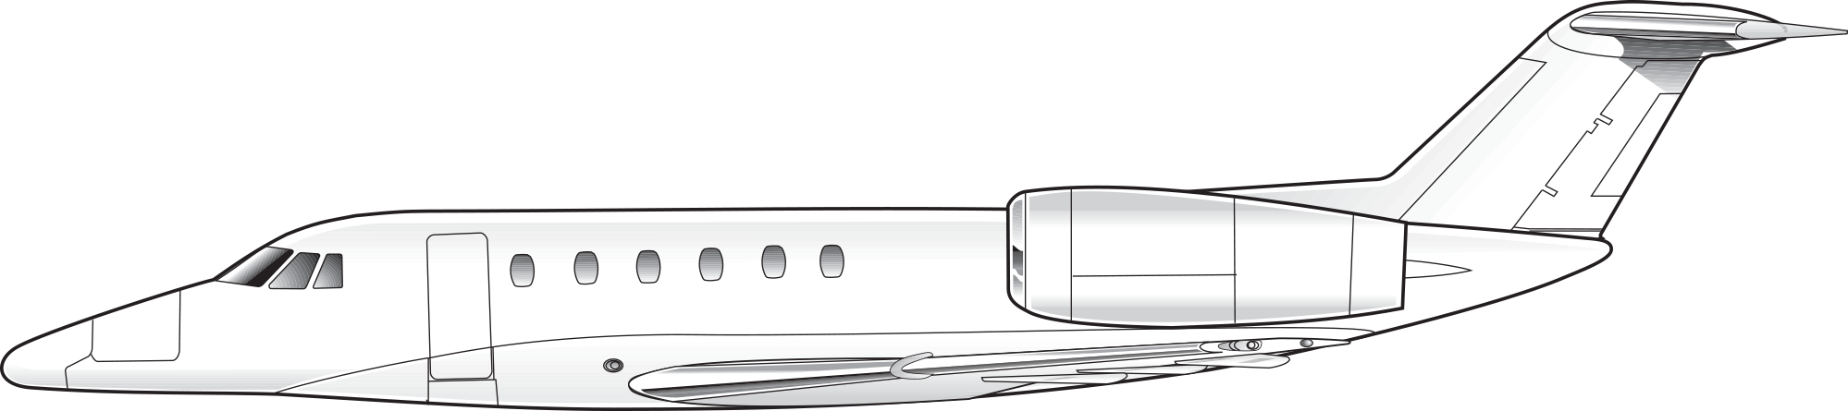
35.
Cessna Citation III/VI/VII/X
Powerplants: two Garrett TFE 731, or Allison GMA 3007A turbofan engines.
Seats: up to 8 passengers.
Cruise speed: 450–510 knots, (0.9 Mach Citation X).
Distinctive features: swept wings; T-tail; unique nose shape; relatively large engines (Citation X).

Slide 38
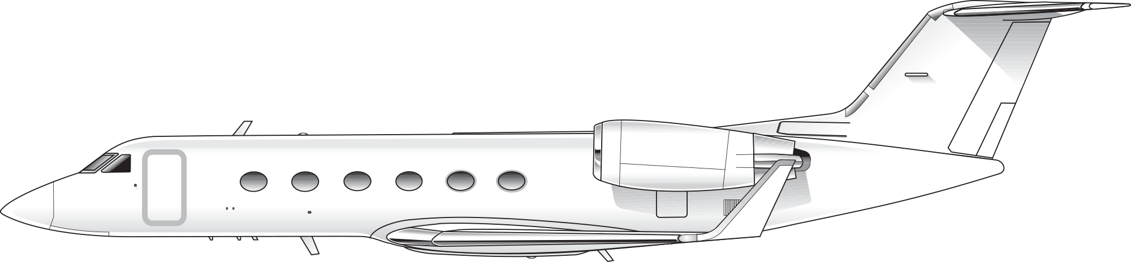
36.
Gulfstream II/III/IV/V/G350/G450/G550/G650
Powerplants: two Rolls-Royce Spey, Rolls-Royce Tay, or BR 710 or BR715 turbofan engines.
Seats: up to 19 passengers.
Cruise speed: 460 knots.
Distinctive features: large size for a corporate jet; flat oval passenger windows; most models have winglets.

Slide 39
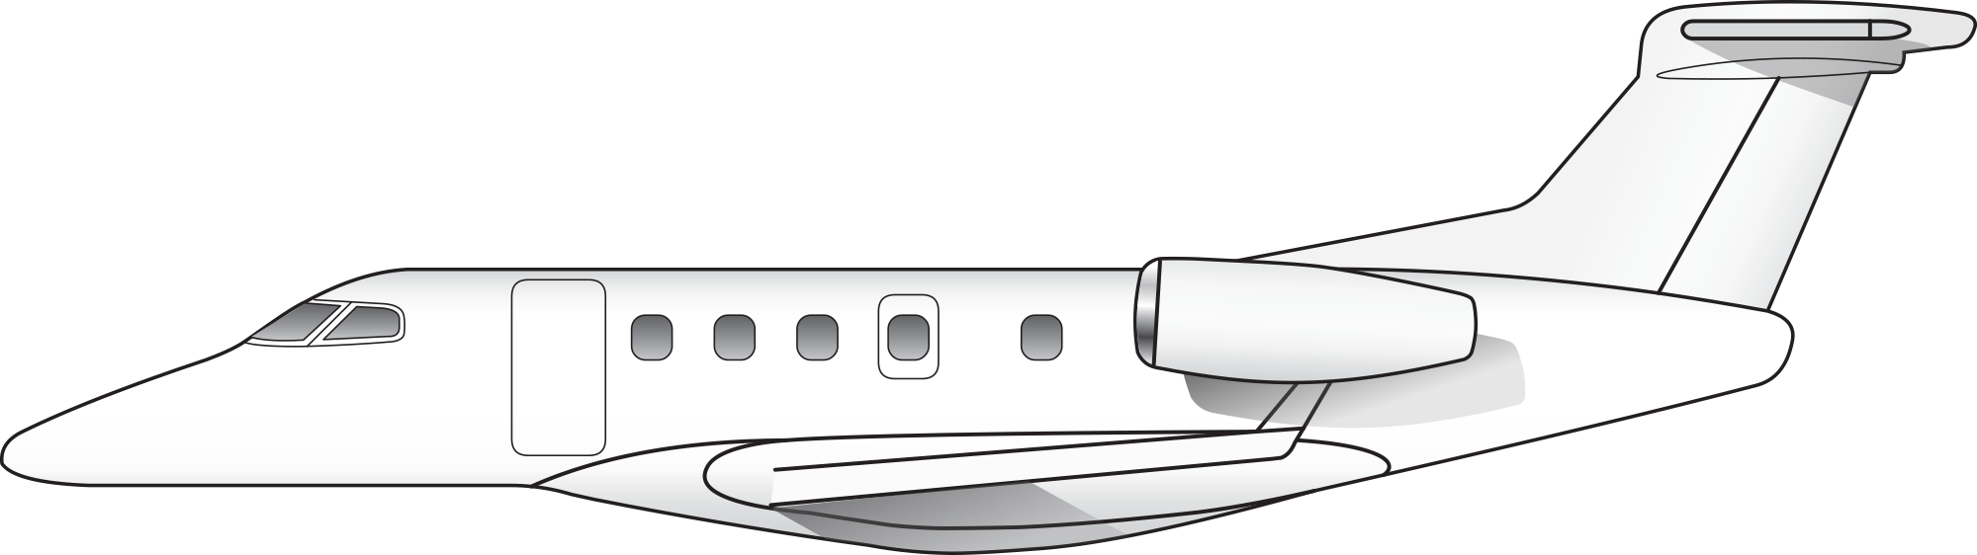
37.
Embraer Phenom 300
Powerplants: two Pratt & Whitney PW535 turbofan engines.
Seats: up to 6 passengers.
Cruise speed: 460 knots.
Distinctive features: distinctive Embraer long sloping nose; large ventral fin.

Slide 40
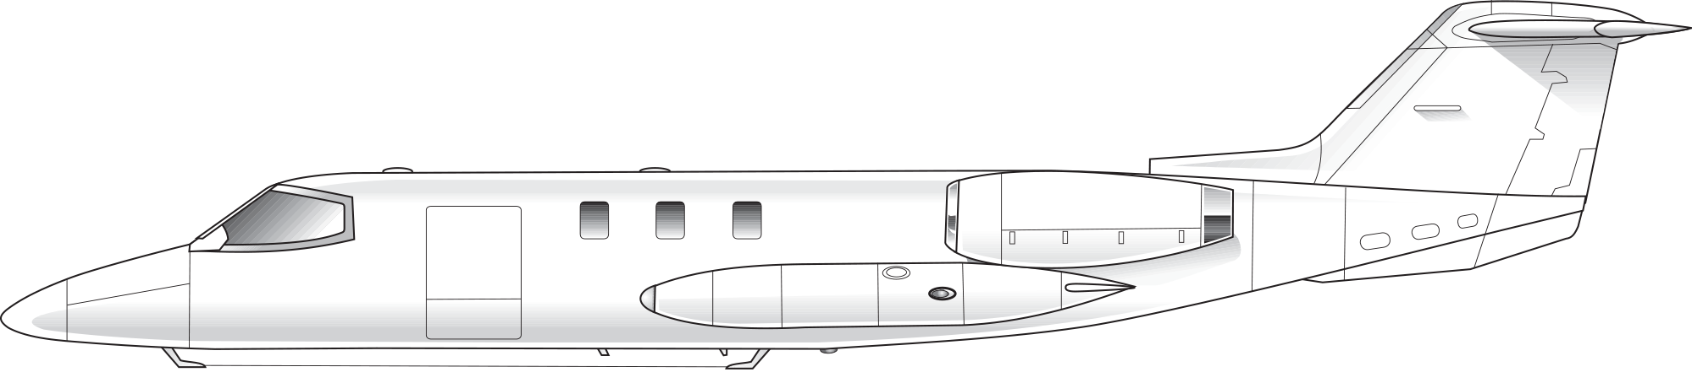
38.
Lear 23/24/25/35/36
Powerplants: two CJ 610 turbojets (23, 24, 25) or two Garrett TFE 731 turbofan engines.
Seats: up to 10 passengers.
Cruise speed: 450 knots.
Distinctive features: distinctive sharp nose; narrow fuselage; wing tip tanks.

Slide 41
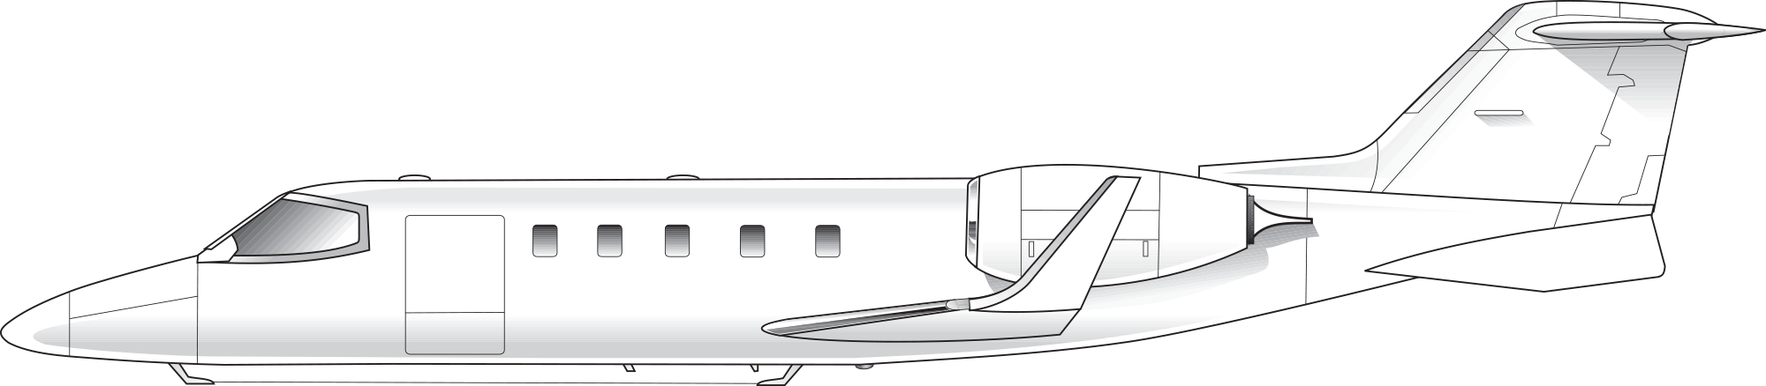
39.
Lear 28/31/40/45/55/60/70/75
Powerplants: two Garrett TFE 731, Pratt & Whitney PW305 or PW307 turbofan engines.
Seats: up to 10 passengers.
Cruise speed: 440 knots.
Distinctive features: narrow fuselage; recent models have winglets.

Slide 42
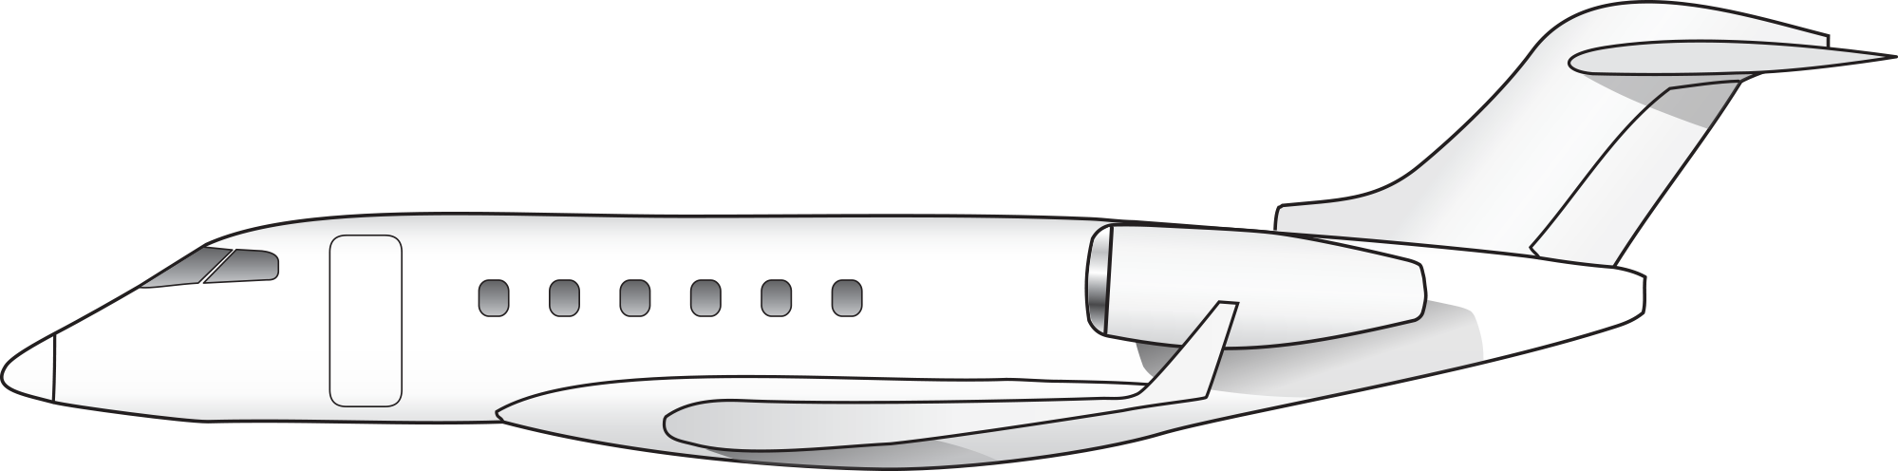
40.
Bombardier Challenger 300 Series
Powerplants: two Honeywell HTF7000 turbofan engines.
Seats: up to 8 passengers.
Cruise speed: 460 knots.
Distinctive features: wide fuselage; large turbofans; large flap-track fairings; winglets.

Slide 43
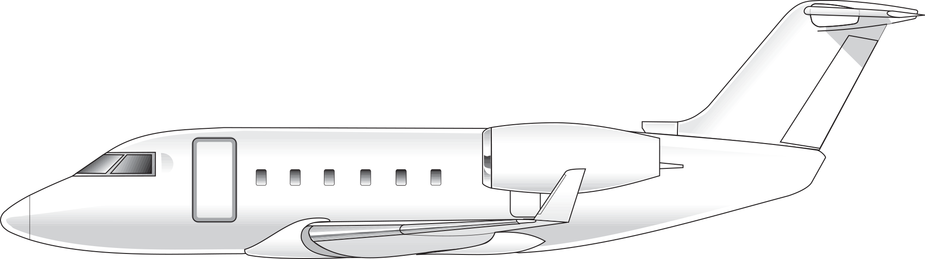
41.
Bombardier Challenger 600 Series
Powerplants: two General Electric CF34 turbofan engines.
Seats: up to 19 passengers.
Cruise speed: 450 knots.
Distinctive features: wide fuselage; large turbofans; wraparound windshield; winglets.

Slide 44
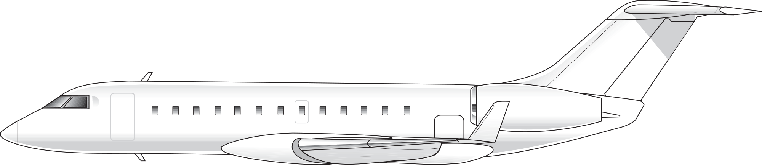
42.
Bombardier Global Express Series
Powerplants: two Rolls-Royce BR700 turbofan engines.
Seats: up to 19 passengers.
Cruise speed: 490 knots.
Distinctive features: winglets; oversized engines; numerous flap-track fairings.

Slide 45
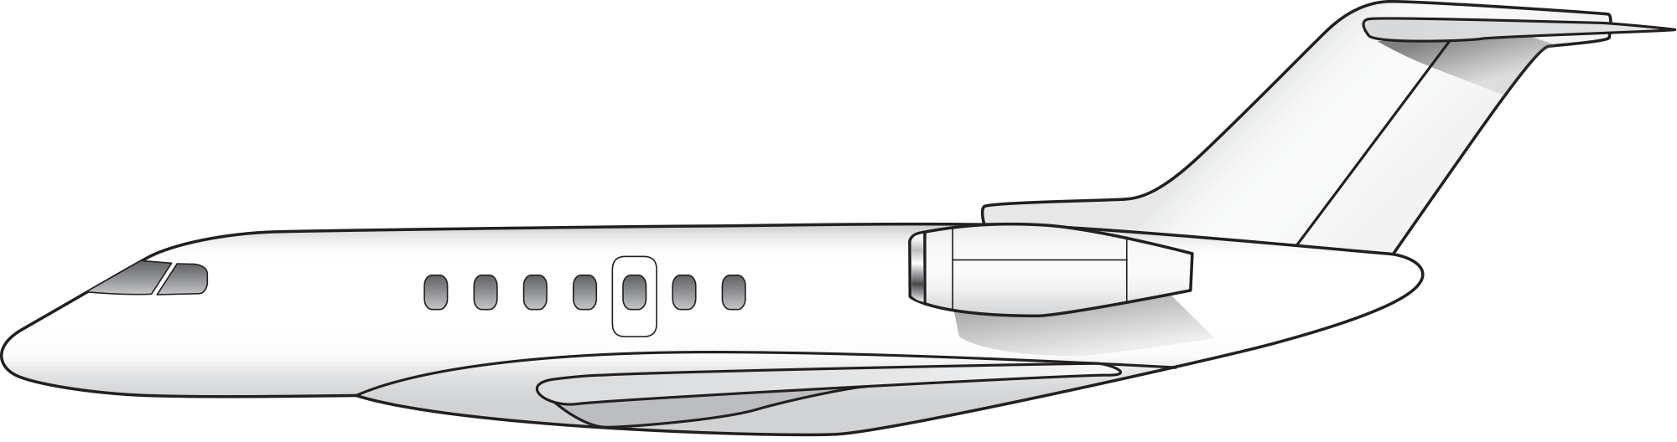
43.
Hawker 4000
Powerplants: two Pratt & Whitney PW308 turbofan engines.
Seats: up to 12 passengers.
Cruise speed: 470 knots.
Distinctive features: continues use of original Hawker-shaped nose with aerodynamic improvements.

Slide 46
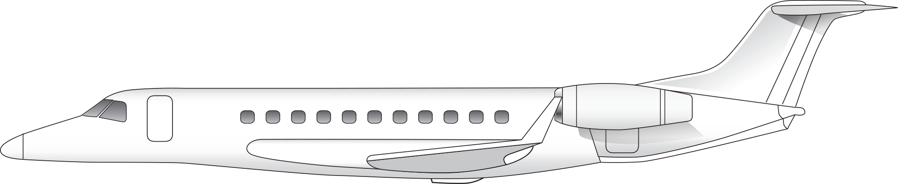
44.
Embraer Legacy 450/500/600/650
Powerplants: two Honeywell HTF7500E turbofan engines (450/500) or Rolls Royce AE3007 turbofan engines (600/650).
Seats: up to 14 passengers (650).
Cruise speed: 450 knots.
Distinctive features: Large flight deck windows; relatively long aircraft for the class; numerous cabin windows.

Slide 47
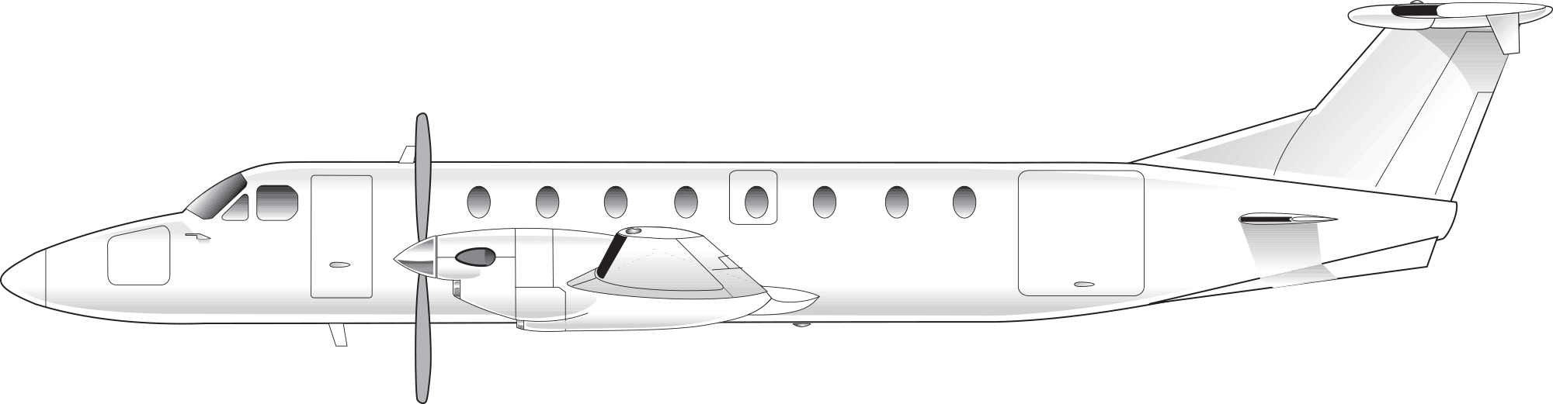
45.
Beechcraft 1900C
Powerplants: two Pratt & Whitney PT6 turboprops.
Seats: up to 19 passengers.
Cruise speed: 250 knots.
Distinctive features: additional fixed horizontal tail surfaces (“stabilons”) on lower rear fuselage; large T-tail with tailets on underside of stabilizer.

Slide 48
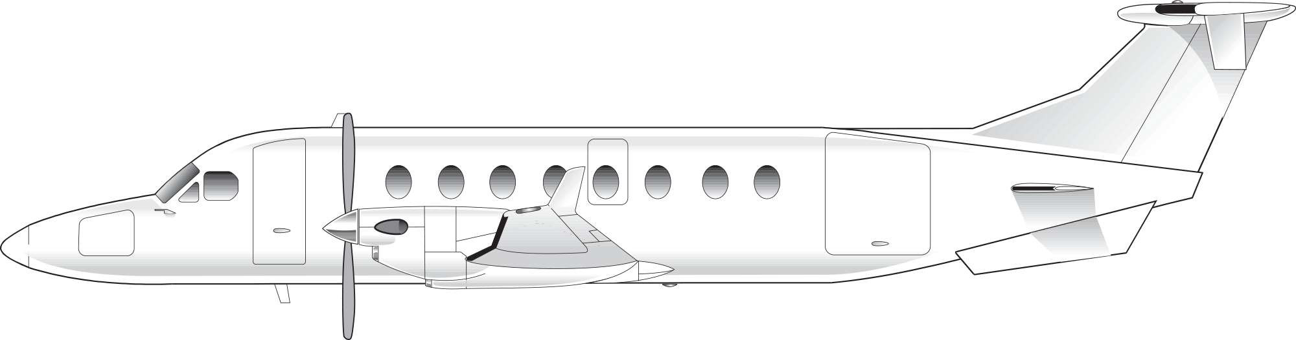
46.
Beechcraft 1900D
Powerplants: two Pratt & Whitney PT6 turboprops.
Seats: up to 19 passengers.
Cruise speed: 260 knots.
Distinctive features: similar to the 1900C but with distinctive vertically extended “stand-up” cabin; stabilons on lower rear fuselage; large T-tail with tailets on underside of horizontal stabilizer.

Slide 49
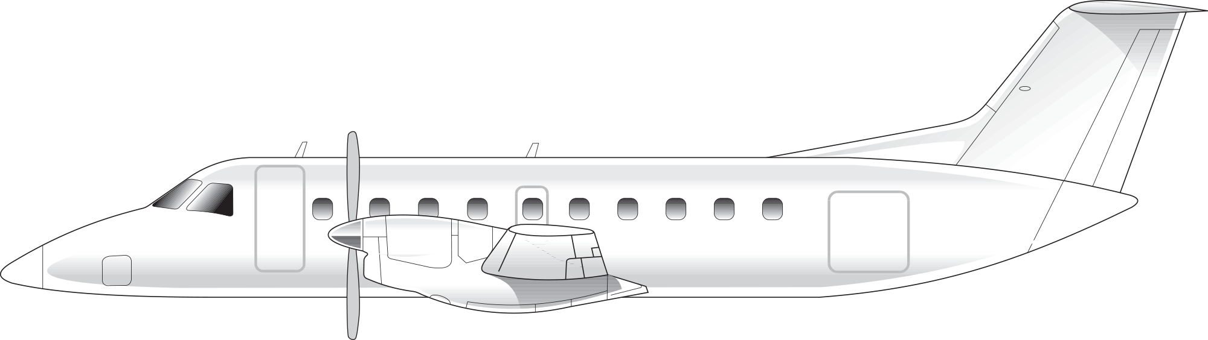
47.
Embraer Brasilia EMB-120
Powerplants: two Pratt & Whitney PW115 or PW118 turboprops.
Seats: up to 30 passengers.
Cruise speed: 300 knots.
Distinctive features: long sloping nose; large wraparound flight deck windows; T-tail.

Slide 50
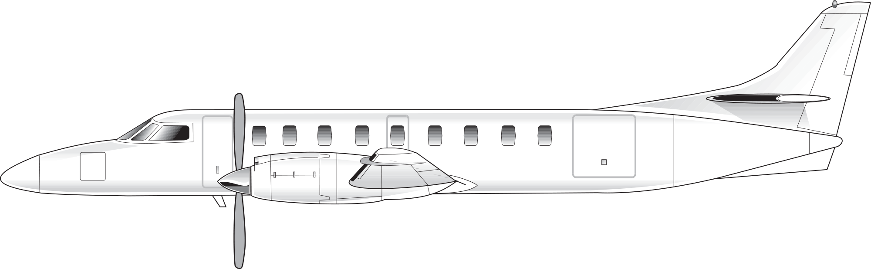
48.
Fairchild Metroliner
Powerplants: two Garrett TPE 331 turboprops.
Seats: up to 19 passengers.
Cruise speed: 290 knots.
Distinctive features: long tubular fuselage; long nose.

Slide 51
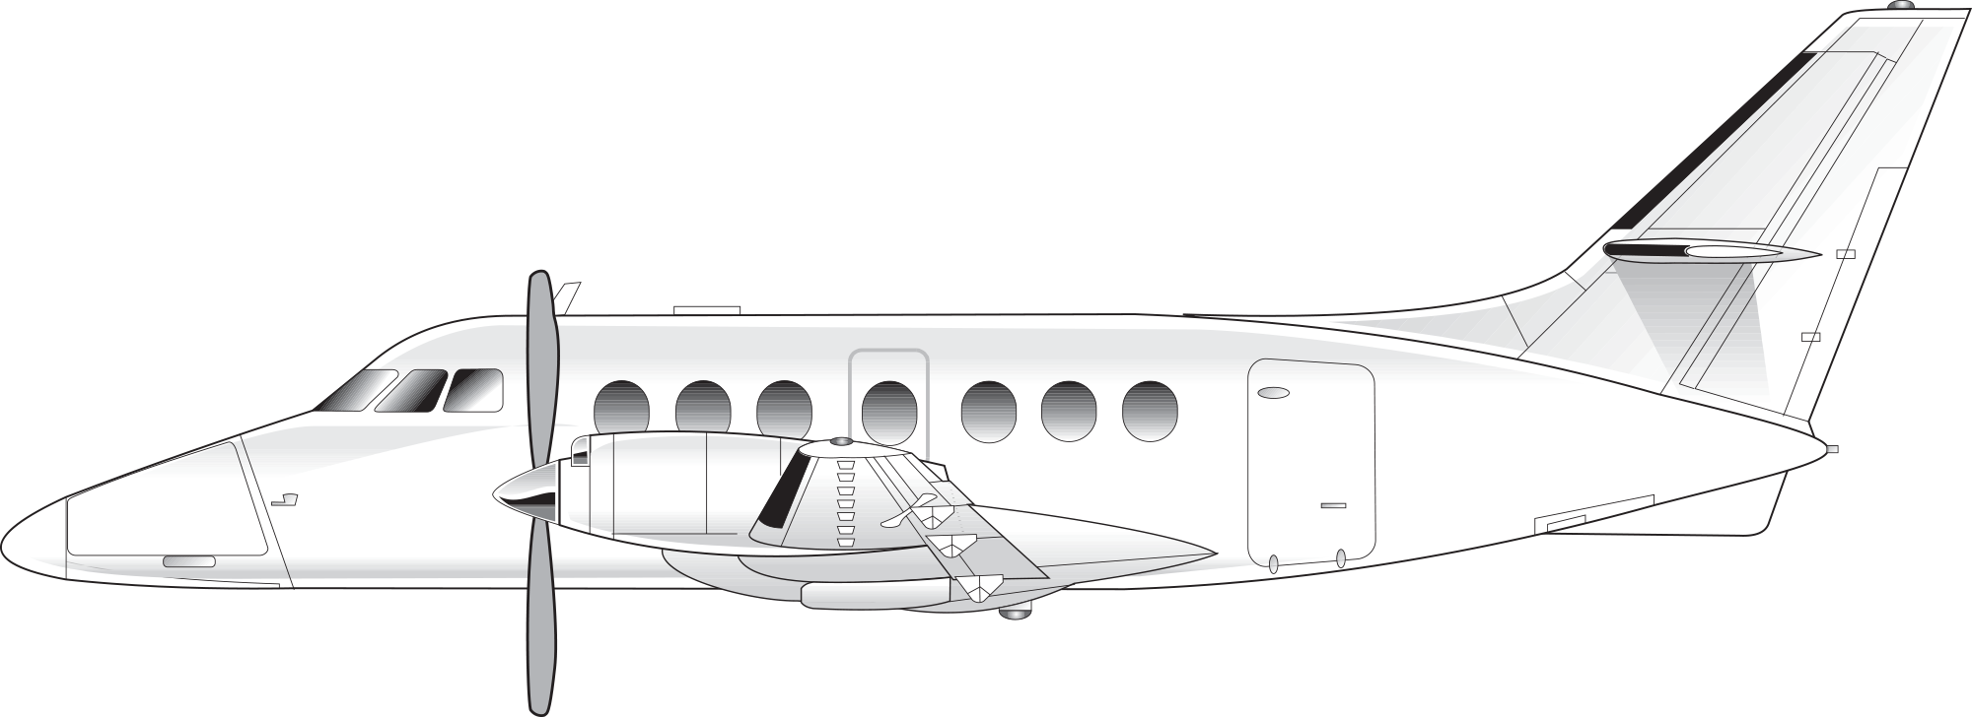
49.
British Aerospace Jetstream 31/Super 31
Powerplants: two Garrett TPE 331 turboprops.
Seats: up to 19 passengers.
Cruise speed: 240 knots.
Distinctive features: long nose; short fuselage; baggage pod on belly of aircraft.

Slide 52
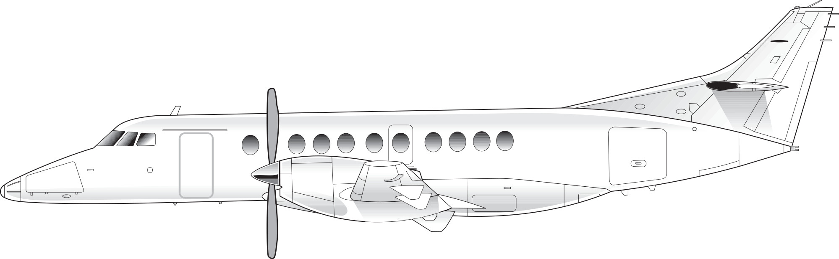
50.
British Aerospace Jetstream 41
Powerplants: two Garrett TPE 331 turboprops.
Seats: up to 30 passengers.
Cruise speed: 250 knots.
Distinctive features: two-piece windshield; similar to Jetstream 31 with stretched fuselage.

Slide 53

51.
Saab 340
Powerplants: two General Electric CT7 turboprops.
Seats: up to 37 passengers.
Cruise speed: 240 knots.
Distinctive features: nose shape; pronounced dihedral of horizontal stabilizer.

Slide 54

52.
British Aerospace ATP
Powerplants: two Pratt & Whitney PW126 turboprops.
Seats: up to 72 passengers.
Cruise speed: 260 knots.
Distinctive features: relatively large size for regional airliner; low horizontal stabilizer with little or no dihedral.

Slide 55

53.
Dornier 228
Powerplants: two Garrett TPE 331 turboprops.
Seats: up to 19 passengers.
Cruise speed: 230 knots.
Distinctive features: high wings; distinctive sloped nose; belly hump houses main landing gear.

Slide 56

54.
Shorts 360
Powerplants: two Pratt & Whitney PT6 turboprops.
Seats: up to 36 passengers.
Cruise speed: 215 knots.
Distinctive features: high wings with struts; boxlike fuselage; pointed nose (earlier 330 models have twin tail).

Slide 57

55.
de Havilland Dash-7
Powerplants: four Pratt & Whitney PT6 turboprops.
Seats: up to 50.
Cruise speed: 210 knots.
Distinctive features: four engines; high-wings; large T-tail.

Slide 58

56.
Fokker F27/F50
Powerplants: two Rolls-Royce Dart or Pratt & Whitney PW125 turboprops.
Seats: up to 50 passengers.
Cruise speed: 270 knots.
Distinctive features: high wings; long pointed nose; main landing gear retract into engine nacelles.

Slide 59

57.
Fairchild/Dornier 328
Powerplants: two Pratt & Whitney PW119 turboprops.
Seats: up to 32 passengers.
Cruise speed: 330 knots.
Distinctive features: small, supercritical wing; belly hump houses main landing gear; unusual slope of nose; distinctive over-wing fairing.

Slide 60

58.
ATR 42/72
Powerplants: two Pratt & Whitney PW120 (ATR42), PW124 and PW127 (ATR72) turboprops.
Seats: up to 50 passengers (ATR42), up to 74 passengers (ATR72).
Cruise speed: 270 knots.
Distinctive features: rounded nose; large vertical tail surface; small wing for an aircraft of this size.

Slide 61

59.
de Havilland Dash-8-100/200/300/400
Powerplants: two Pratt & Whitney PW120, PW123, PW150 turboprops.
Seats: up to 78 passengers.
Cruise speed: 360 knots.
Distinctive features: slope of nose; large T-tail; wraparound flight deck windows.

Slide 62

60.
Canadair Regional Jet CRJ 200/700/900
Powerplants: two General Electric CF34 turbofan engines.
Seats: up to 86 passengers.
Cruise speed: 450 knots.
Distinctive features: stretched version of Canadair Challenger; large wraparound flight deck windows; large turbofan engines; winglets.

Slide 63

61.
British Aerospace BAe 146/Avro RJ
Powerplants: four Lycoming ALF 502 or LF507 turbofan engines.
Seats: up to 112 passengers.
Cruise speed: 430 knots.
Distinctive features: four turbofan engines; high wings; T-tail.

Slide 64

62.
Fairchild/Dornier 328 Jet
Powerplant: two General Electric CF34 turbofan engines.
Seats: up to 34 passengers.
Cruise speed: 405 knots.
Distinctive features: similar in appearance to the Fairchild/Dornier 328 turboprop, except it has turbofan engines.

Slide 65

63.
Embraer 135/145
Powerplants: two Rolls-Royce AE3007 turbofan engines.
Seats: up to 50 passengers.
Cruise speed: 440 knots.
Distinctive features: long, slender fuselage.

Slide 66

64.
Bombardier Canadair Regional Jet CRJ 200/700/900/1000
Powerplants: two General Electric CF34 turbofan engines.
Seats: up to 104 passengers (CRJ 1000).
Cruise speed: 450 knots.
Distinctive features: stretched version of Canadair Challenger; large wraparound flight deck windows; large-diameter turbofan engines; winglets.

Slide 67

65.
Mitsubishi Regional Jet (MRJ)
Powerplants: two Pratt & Whitney 1200G Series turbofan engines.
Seats: up to 92 passengers.
Cruise speed: 450 knots.
Distinctive features: pointed nose; relatively narrow fuselage; sits slightly nose-low on its gear.

Slide 68

66.
Boeing 717
Powerplants: two BMW/Rolls-Royce BR 715 turbofan engines.
Seats: up to 117.
Cruise speed: 440 knots.
Distinctive features: looks similar to DC-9; large diameter engines; squared-off tail.

Slide 69

67.
McDonnell Douglas MD-80 series/MD-90
Powerplants: two Pratt & Whitney JT8D or IAE V2500 (MD-90) turbofan engines.
Seats: up to 172 passengers.
Cruise speed: 440 knots.
Distinctive features: long, narrow fuselage; stretched version of DC-9 with similar flight deck window layout; larger diameter engine nacelles than the DC-9.

Slide 70

68.
Boeing 727
Powerplants: three Pratt & Whitney JT8D turbofan engines.
Seats: up to 190 passengers.
Cruise speed: 490 knots.
Distinctive features: three tail-mounted engines, with the number two engine intake mounted in the vertical stabilizer and utilizing an S-shaped intake duct (numbers one and three engines feature standard straight axial flow).

Slide 71

69.
Embraer 170/190
Powerplants: two GE CF34 turbofan engines.
Seats: up to 122 passengers.
Cruise speed: 440 knots.
Distinctive features: similar in appearance to Airbus 320; winglets; long APU-exhaust tailcone.

Slide 72

70.
Boeing 737-300/400/500 (737 “Classic” Series)
Powerplants: two General Electric/SNECMA CFM56 turbofan engines.
Seats: up to 170 passengers (737-400).
Cruise speed: 440 knots.
Distinctive features: large engine intakes are flattened at the bottom for ground clearance, not perfectly circular like most turbofan engines.

Slide 73

71.
Boeing 737-600/700/800/900 (737 “New Generation”)
Powerplants: two General Electric/SNECMA CFM 56-7B turbofan engines.
Seats: up to 177 passengers (737-900).
Cruise speed: 440 knots.
Distinctive features: looks very similar to “Classic” 737 series; wingspan is nearly 8 feet longer, tail 5 feet taller; aircraft sits about 18 inches higher on the main gear, so engine intake shape is more rounded than 300/400/500.

Slide 74

72.
Boeing 737 Max -7, -8, -9, -10
Powerplants: two CFM International LEAP-1B turbofan engines. LEAP stands for “Leading Edge Aviation Propulsion.”
Seats: up to 230 (Max 10).
Cruise speed: 450 knots.
Distinctive features: Split tip winglets; large diameter engines (7" larger diameter than 737NG models); engine nacelle features noise-reducing saw-tooth or “chevron” trailing edge.

Slide 75

73.
Airbus A319/320/321 neo (“new engine option”)
Powerplants: two CFM International LEAP-1A or Pratt & Whitney PW1100G turbofan engines.
Seats: up to 240 passengers (A321neo).
Cruise speed: 450 knots.
Distinctive features: large-diameter engines (13" larger diameter than original A319/320/321); large sharklet winglets.

Slide 76

74.
Airbus A318/A319/A320/A321 Series
Powerplants: two General Electric/SNECMA CFM56 or IAE V2500 turbofan engines.
Seats: up to 180 passengers.
Cruise speed: 450 knots.
Distinctive features: extended tail cone; numerous flap extension fairings on wing trailing edges; distinctive winglets.

Slide 77

75.
Airbus 220-100/300
Powerplants: two Pratt & Whitney PW1500G turbofan engines.
Seats: up to 130 passengers (300).
Cruise speed: 450 knots.
Distinctive features: Large-diameter, geared turbofan engines; pronounced pointed nose; futuristically shaped flight deck windows.

Slide 78

76.
Comac C919
Powerplants: two CFM International LEAP-1C turbofan engines.
Seats: up to 168 passengers.
Cruise speed: 450 knots.
Distinctive features: Large-diameter turbofan engines; rounded nose; similar in size and shape to Airbus A320.

Slide 79

77.
Embraer E175-E2/E190-E2/E195-E2
Powerplants: two Pratt & Whitney PW1715G or PW1900G series turbofan engines.
Seats: up to 120 passengers.
Cruise speed: 450 knots.
Distinctive features: large-diameter engines; long down-sloped nose; raked (i.e., pointed) wingtips.

Slide 80

78.
Sukhoi SuperJet 100
Powerplants: two PowerJet SaM146 turbofan engines.
Seats: up to 108 passengers.
Cruise speed: 450 knots.
Distinctive features: pronounced pointed nose; relatively small diameter engine intakes.

Slide 81

79.
Boeing 757-200/300
Powerplants: two Rolls-Royce RB211 or Pratt & Whitney PW2000 Series turbofan engines.
Seats: up to 225 passengers (757-200), up to 243 passengers (757-300).
Cruise speed: 460 knots.
Distinctive features: long, slender fuselage with very large engine nacelles and tall landing gear; distinctive nose shape; clean supercritical wing; winglets.

Slide 82

80.
Boeing 767-200/300/400
Powerplants: two General Electric CF6, Rolls-Royce RB211, Pratt & Whitney JT9D or PW4000 Series turbofan engines.
Seats: up to 305 passengers.
Cruise speed: 460 knots.
Distinctive features: wide-body relative of Boeing 757; clean supercritical wing design; rounded nose; many have large winglets.

Slide 83

81.
Airbus A310
Powerplants: two General Electric CF6 or Pratt & Whitney JT9D or PW4000 Series turbofan engines.
Seats: up to 240.
Cruise speed: 450 knots.
Distinctive features: similar to Boeing 767 but with numerous flap-extension fairings on wing trailing edges; some have winglets.

Slide 84

82.
Airbus A330
Powerplants: two General Electric CF6 or Rolls-Royce Trent turbofan engines.
Seats: up to 330 passengers.
Cruise speed: 490 knots.
Distinctive features: winglets; extended tailcone.

Slide 85

83.
Airbus A300
Powerplants: General Electric CF6 or Pratt & Whitney JT9D turbofan engines.
Seats: up to 300 passengers.
Cruise speed: 450 knots.
Distinctive features: similar to Boeing 767 but has numerous flap extension fairings on the wing trailing edges; similar to A-310 but has longer fuselage.

Slide 86

84.
Boeing 787-8/-9/-10
Powerplants: two General Electric GEnx, or Rolls-Royce Trent turbofan engines.
Seats: up to 280 passengers.
Cruise speed: 490 knots
Distinctive features: engine nacelles feature noise-reducing saw-tooth trailing edge; four-panel windshield; smooth nose contour; similar size and profile to 767-300.

Slide 87

85.
Boeing 777
Powerplants: two Pratt & Whitney PW4000 Series, General Electric GE90, or Rolls-Royce Trent turbofan engines.
Seats: up to 400 passengers.
Cruise speed: 490 knots
Distinctive features: massive fuselage size; large-diameter engine nacelles (the GE90 nacelle diameters are larger than MD80 / B717 fuselage diameter!); clean supercritical wing design; tailcone tapers to a flat vertical edge; similar in appearance to the 767 or A330.

Slide 88

86.
Airbus 330 neo (“new engine option”)
Powerplants: two Rolls-Royce Trent 7000 turbofan engines.
Seats: up to 280 passengers.
Cruise speed: 490 knots.
Distinctive features: curled winglets; extended tailcone.

Slide 89

87.
Airbus A350
Powerplants: two Rolls-Royce Trent XWB turbofan engines.
Seats: up to 440.
Cruise speed: 490 knots.
Distinctive features: curled winglets; futuristic flight deck windows; pointed nose.

Slide 90

88.
McDonnell Douglas DC-10/MD-10
Powerplants: three General Electric CF6 or Pratt & Whitney JT9D turbofan engines.
Seats: up to 380 passengers.
Cruise speed: 490 knots.
Distinctive features: number two engine mounted in tail; number two engine nacelle straight from intake to exhaust.

Slide 91

89.
McDonnell Douglas MD-11
Powerplants: three General Electric CF6 or Pratt & Whitney PW4000 Series turbofan engines.
Seats: up to 405 passengers.
Cruise speed: 470 knots.
Distinctive features: similar to but longer than DC-10; large winglets.

Slide 92

90.
McDonnell Douglas DC-8
Powerplants: four Pratt & Whitney JT3D or General Electric/SNECMA CFM56 turbofan engines.
Seats: up to 250 passengers.
Cruise speed: 490 knots.
Distinctive features: four engines; long, narrow fuselage; most are currently used to haul freight.

Slide 93

91.
Airbus A-340 Series
Powerplants: four General Electric/SNECMA CFM56 or Rolls-Royce Trent turbofans.
Seats: up to 400 passengers.
Cruise speed: 490 knots.
Distinctive features: four engines; winglets.

Slide 94

92.
Boeing 747-100/SP/200/300
Powerplants: four Pratt & Whitney JT9D, General Electric CF6, or Rolls-Royce RB211 turbofan engines.
Seats: up to 500 passengers.
Cruise speed: 500 knots.
Distinctive features: four engines; bulge on top of fuselage for upper-deck seating (747 SP is shorter than other models).

Slide 95

93.
Boeing 747-400/747-8
Powerplants: four General Electric CF6, Rolls-Royce RB211, Pratt & Whitney 4000 Series or GEnx Series turbofan engines.
Seats: up to 600 passengers.
Cruise speed: 485 knots.
Distinctive features: four engines; large winglets; extended upper deck.

Slide 96

94.
Airbus A-380 Series
Powerplants: four GP7000 or Rolls-Royce Trent turbofan engines.
Seats: up to 650 passengers.
Cruise speed: 490 knots.
Distinctive features: massive aircraft; four large-diameter engines; full-fuselage-length double-deck passenger cabin; massive four-strut, 20-tire main landing gear; winglets similar in design to A310 and A320.

