Slide 1


Instructor Resources
Appendix 3 Figures
Cover photo: BeautyStock – stock.adobe.com.

Slide 2
Appendix 3
Transport Airplane Performance and Operating Limitations

Slide 3
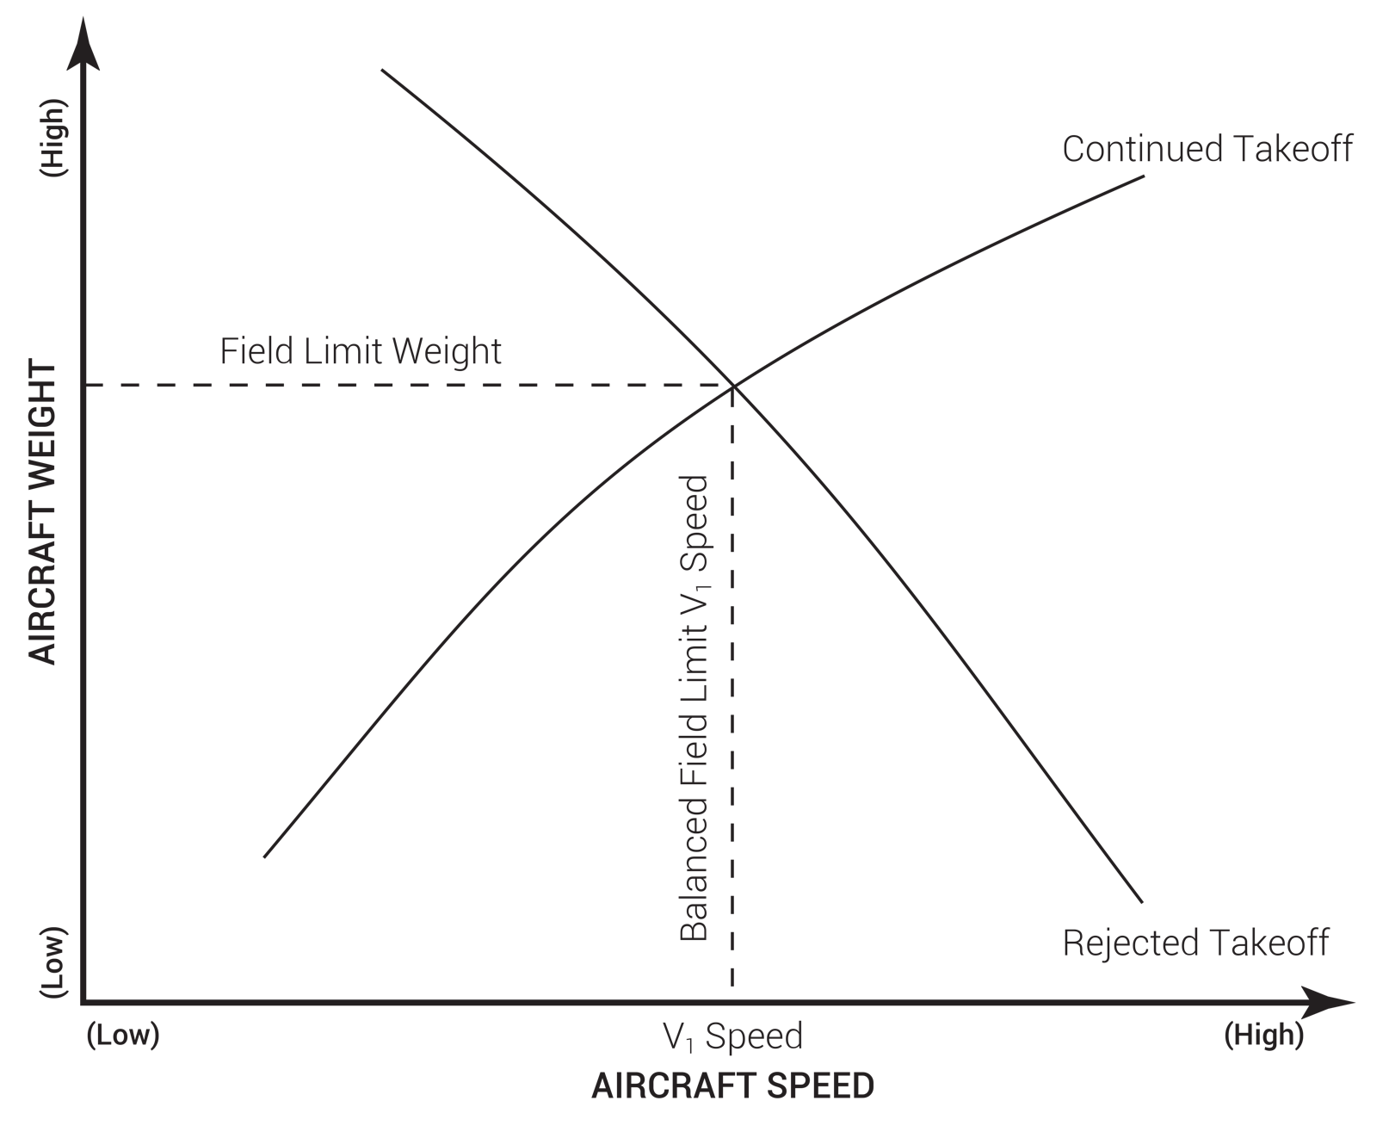
FIGURE A.1
Balanced field length.

Slide 4
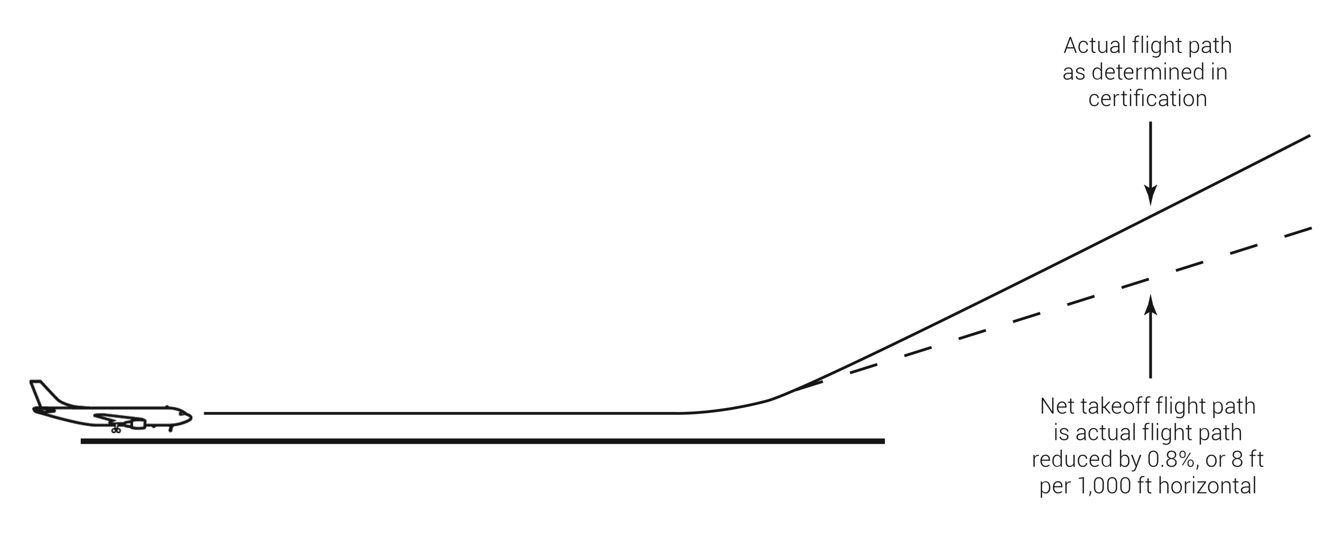
FIGURE A.2
Net takeoff flight path.

Slide 5
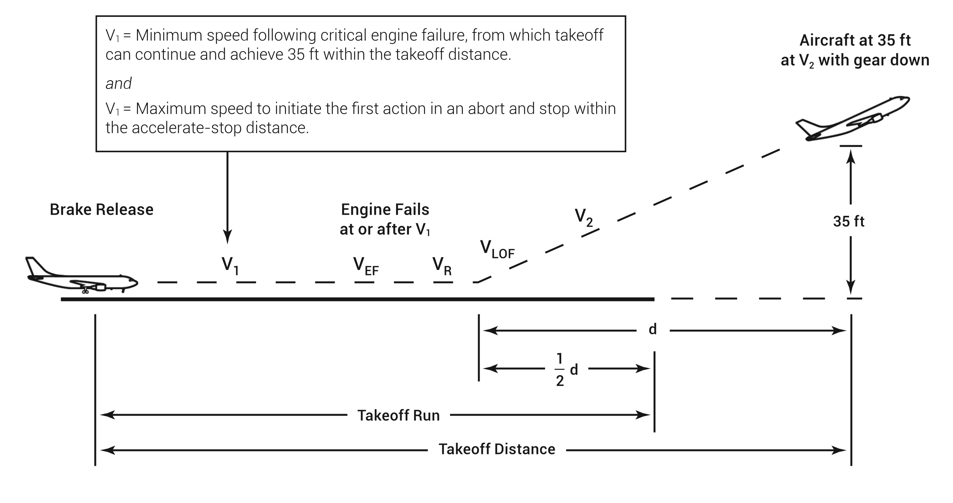
FIGURE A.3
Takeoff run vs. takeoff distance.

Slide 6
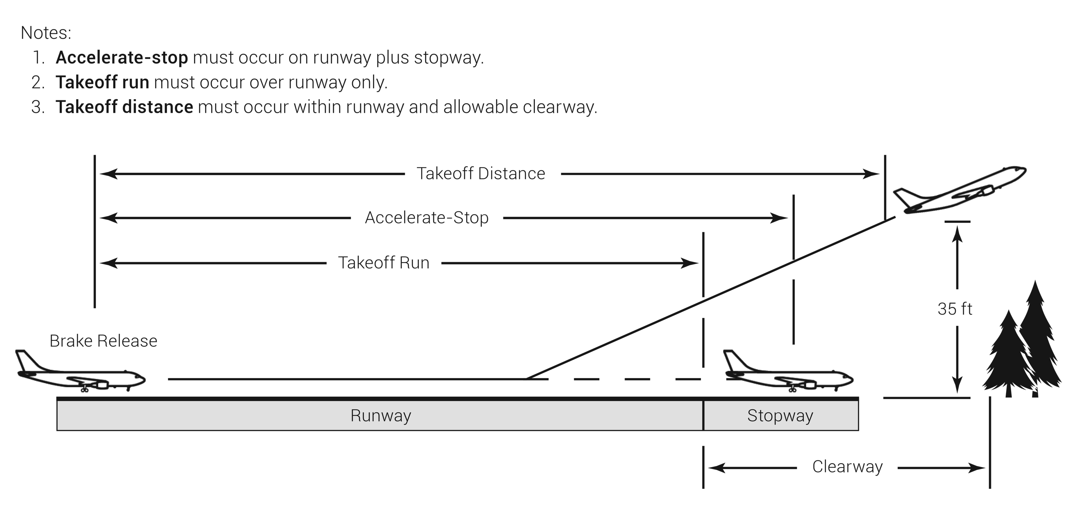
FIGURE A.4
Takeoff run over a clearway.

Slide 7
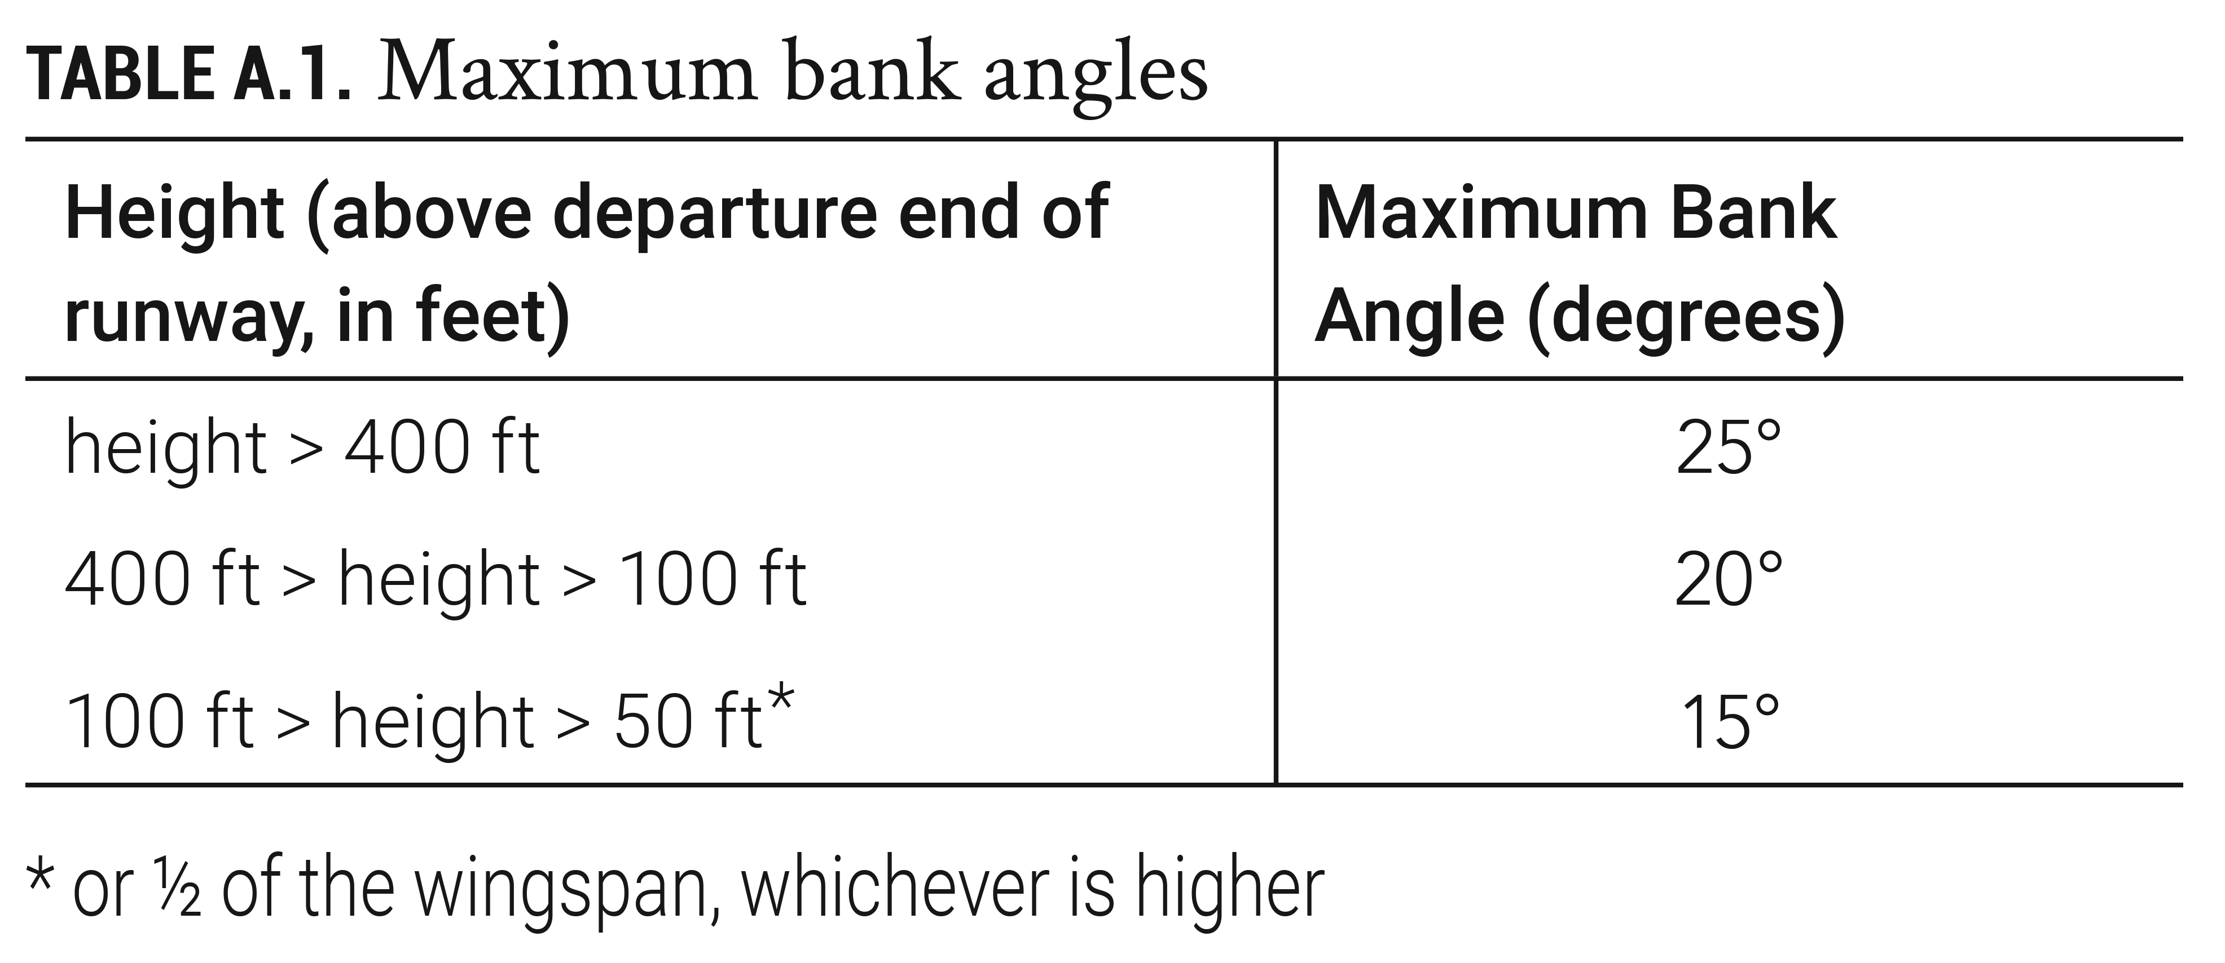
TABLE A.1
Maximum bank angles.

Slide 8
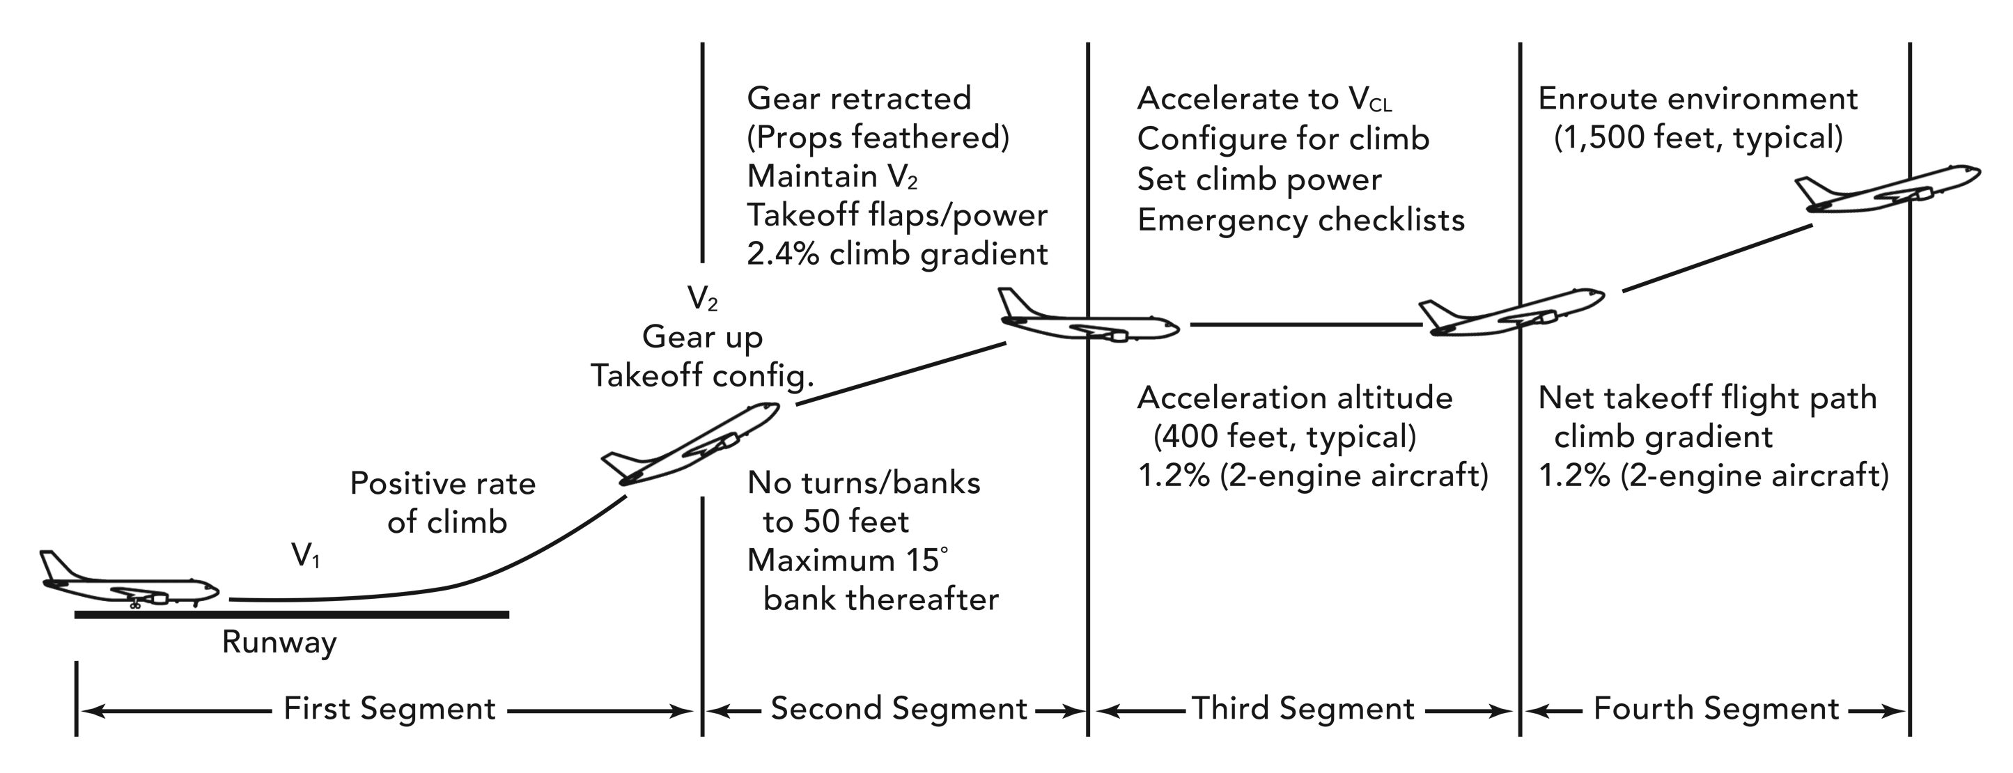
FIGURE A.5
Twin engine, four segment climb.

Slide 9
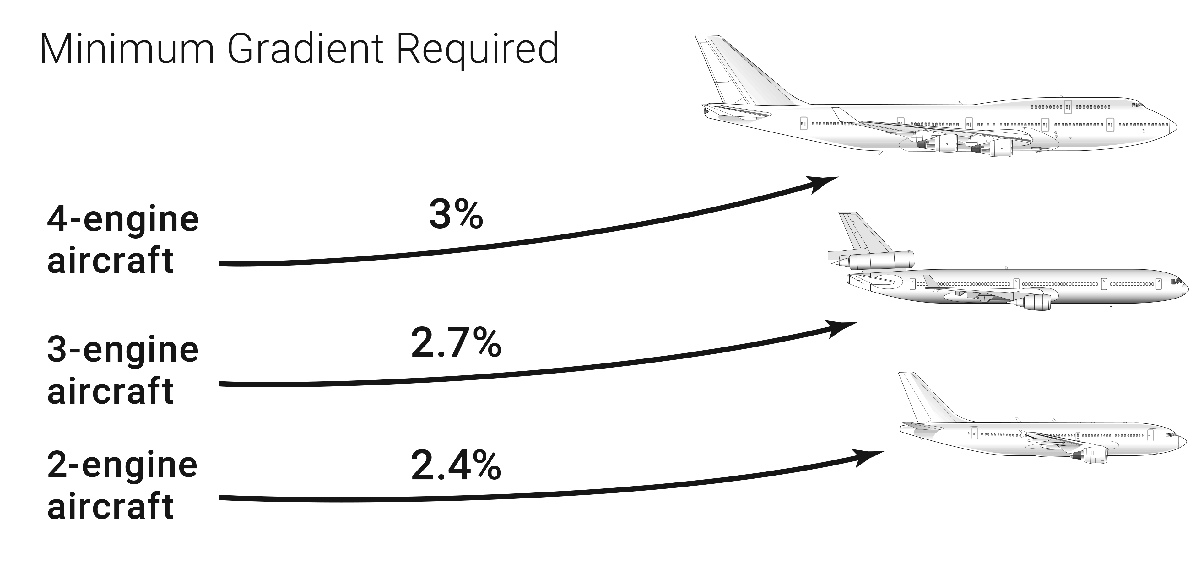
FIGURE A.6
Required second segment climb performance at climb limit weight.

Slide 10
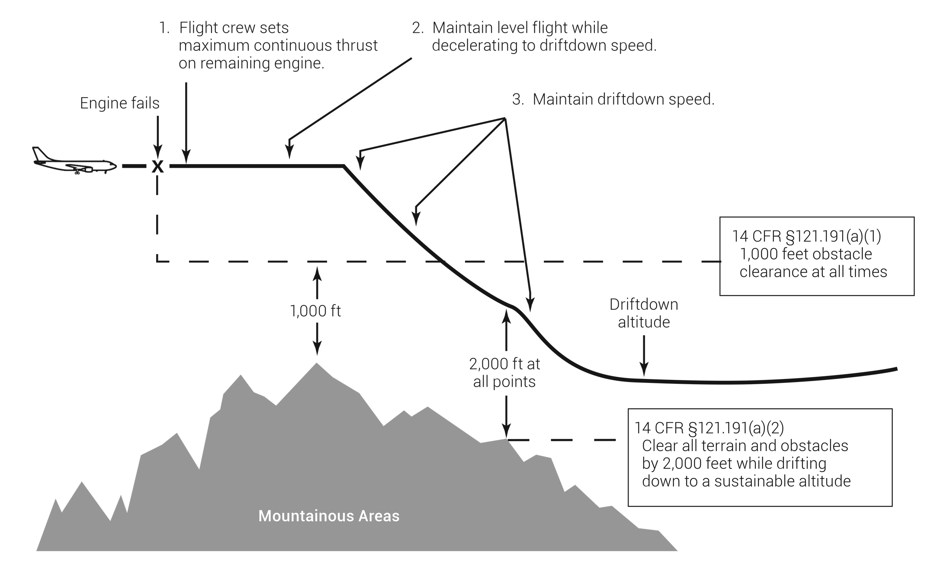
FIGURE A.7
Driftdown procedure.

Slide 11
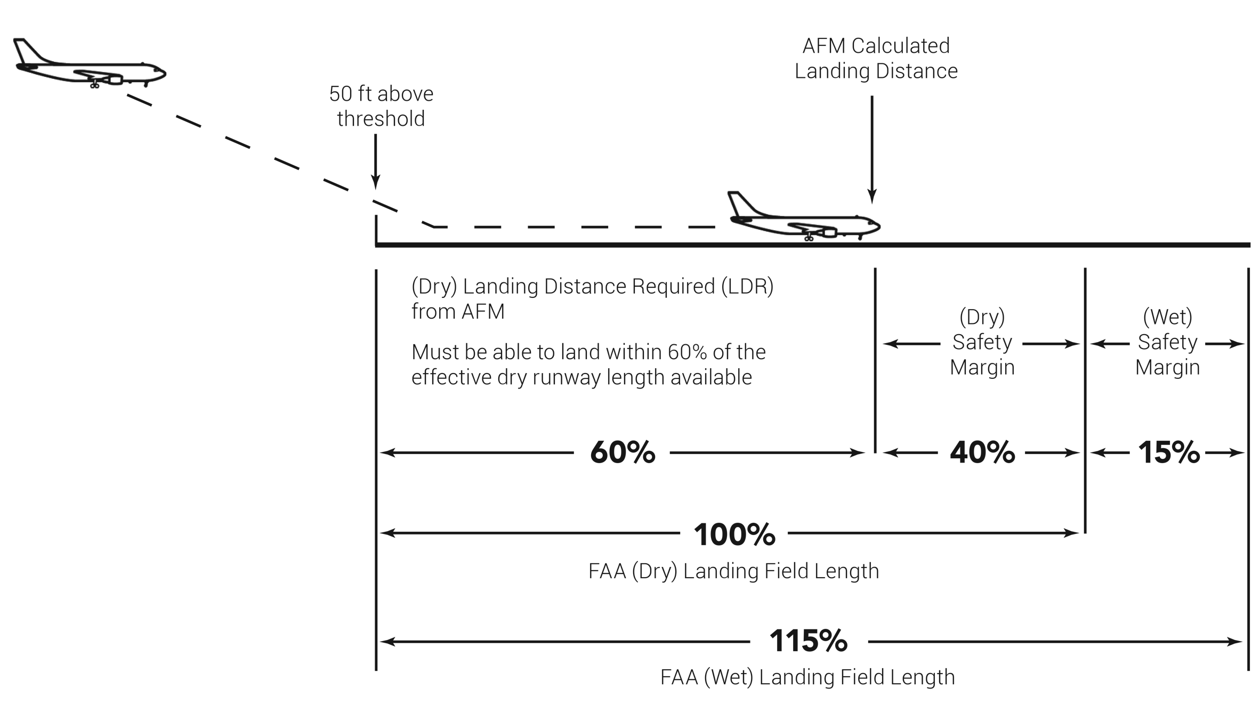
FIGURE A.8
Landing distance limitations.

Slide 12
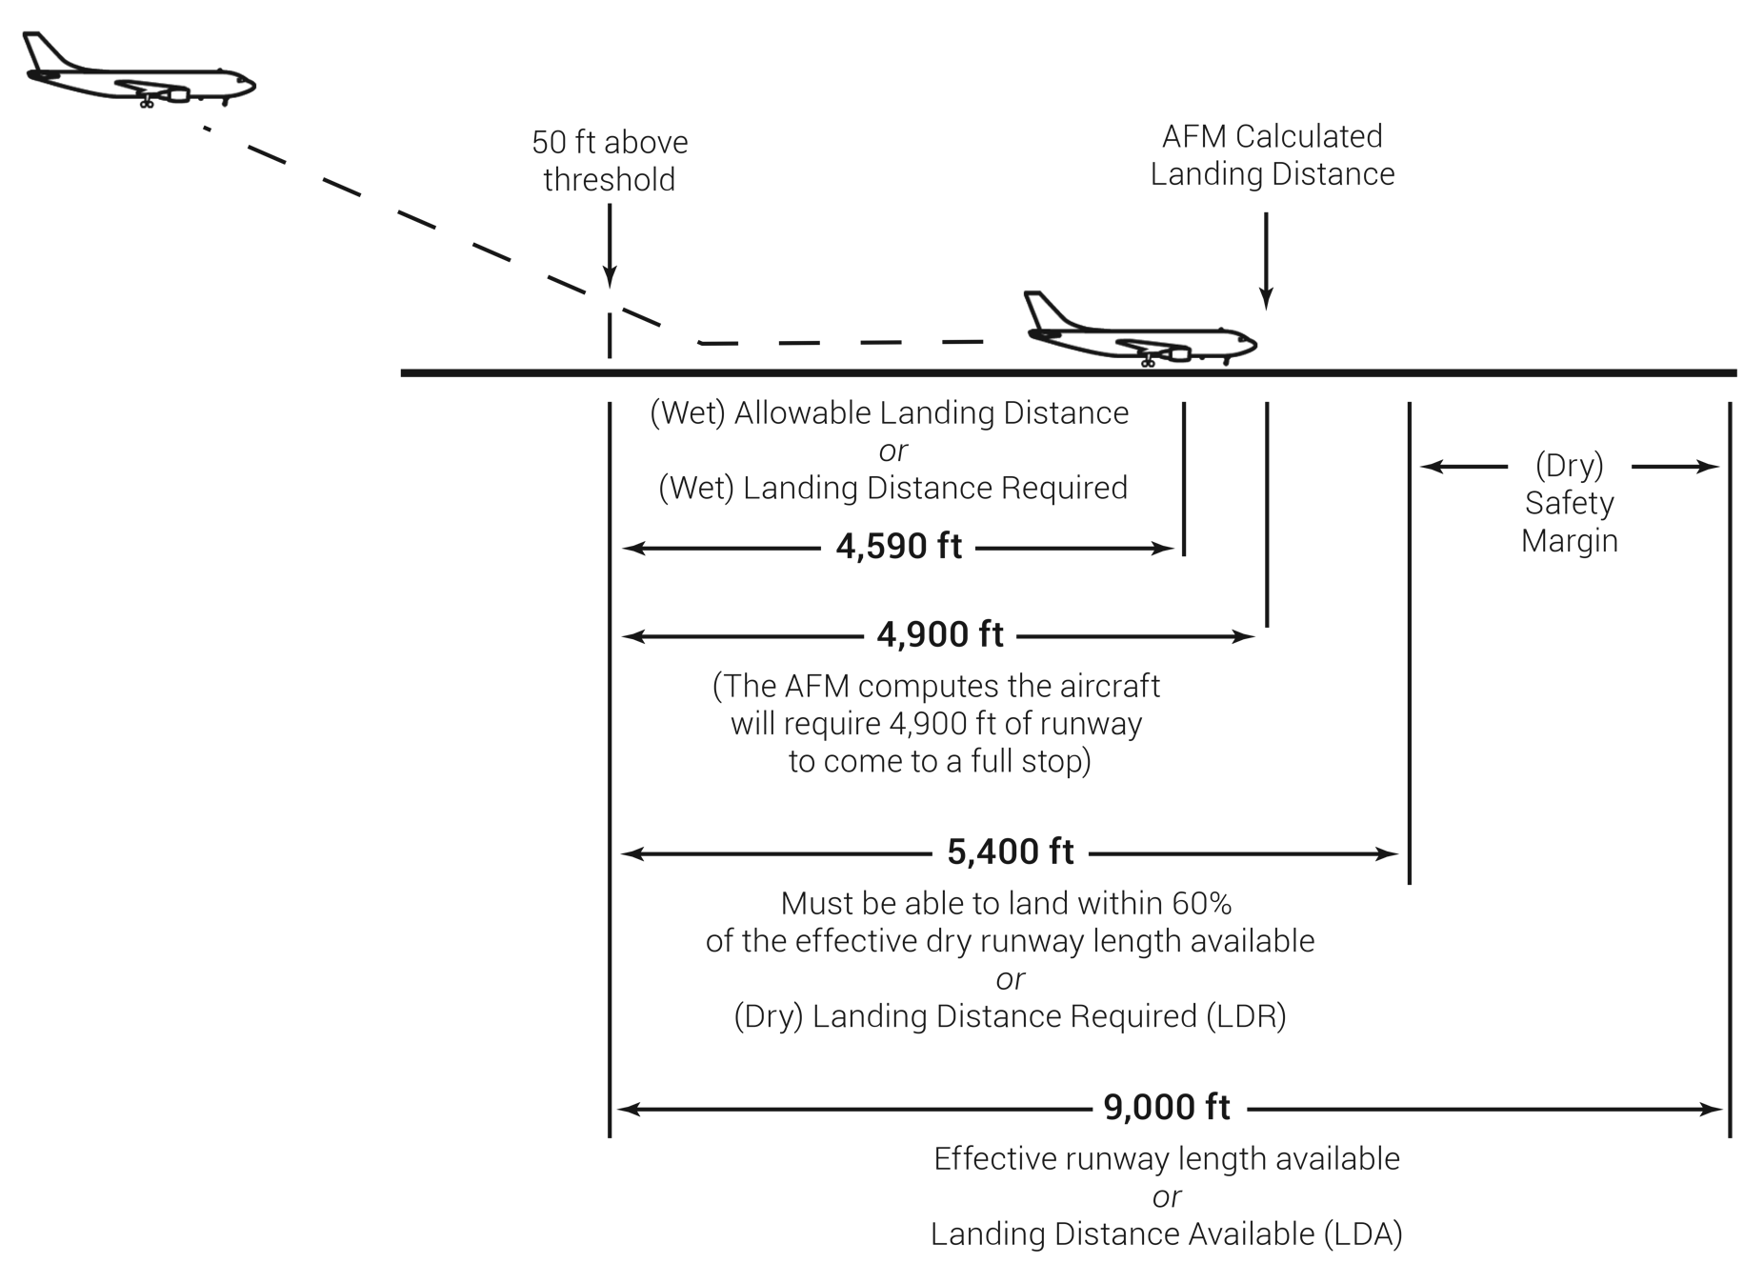
FIGURE A.9
Sample landing distance limitation problem.

Slide 13
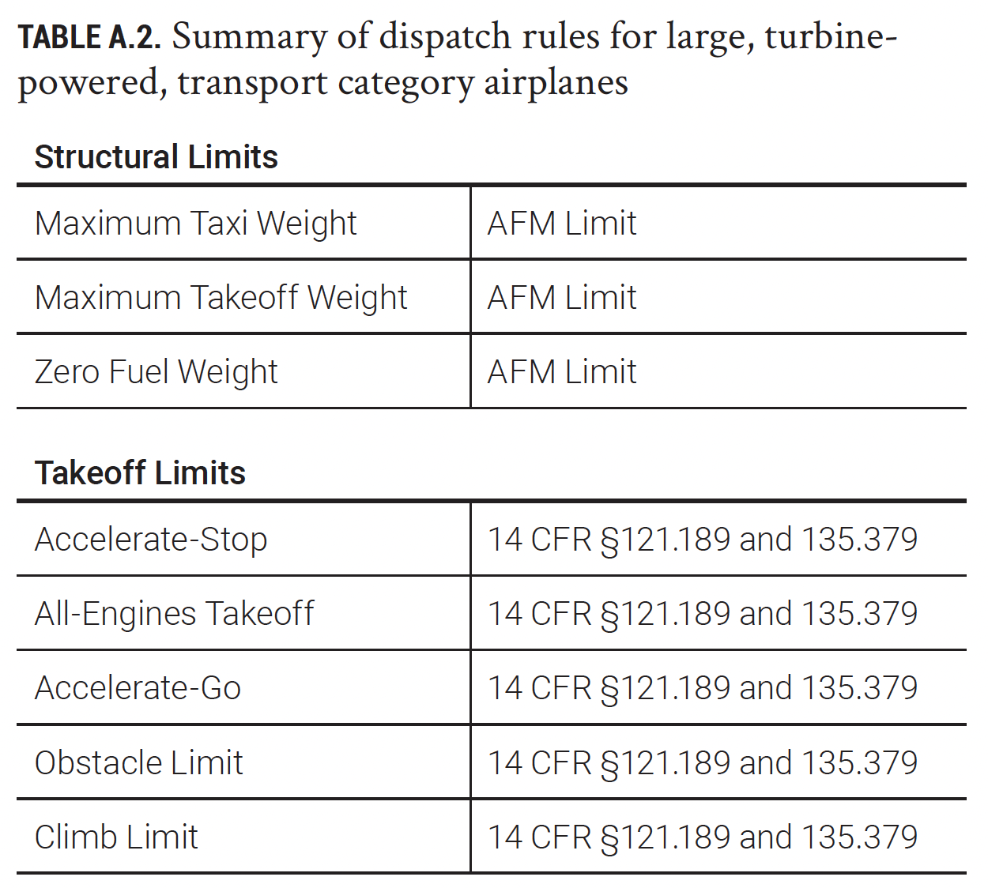
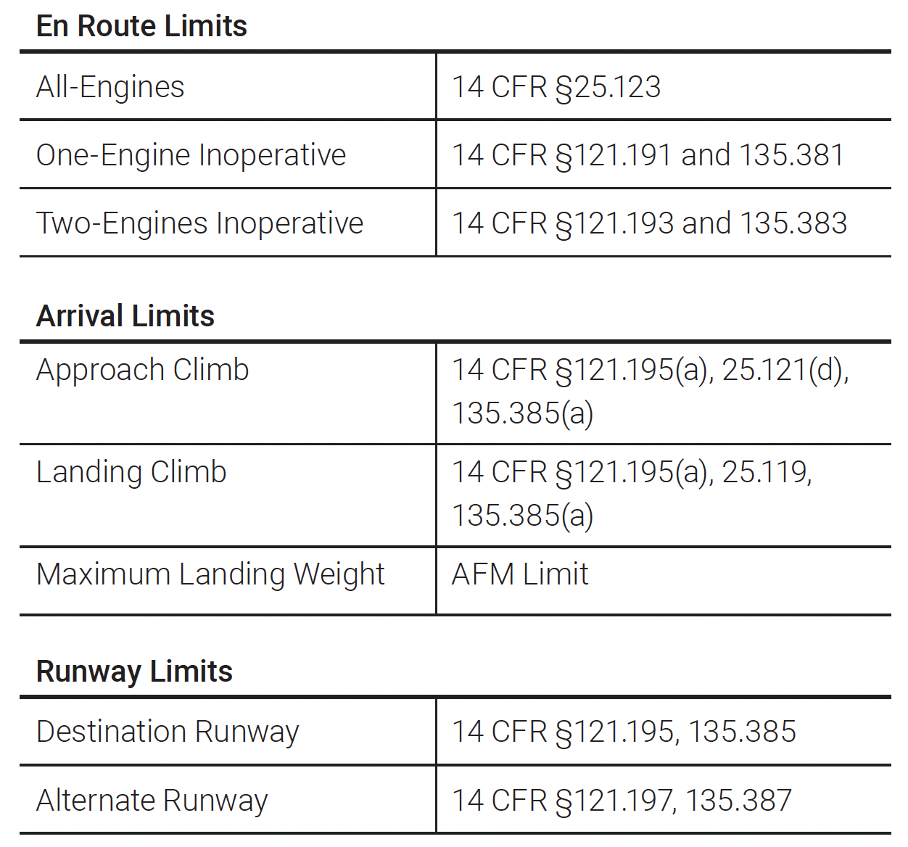
TABLE A.2
Summary of dispatch rules for large, turbine-powered, transport category airplanes

